Slide 1
Understanding social conflict:
How to avoid talking past each other
Rene Brauer, PhD
r.brauer@hull.ac.uk

Slide 2
Introduction
Who am I?
Aim of the presentation
Outline of the presentation
    Background: Welcome to Gothenburg NorthEast &
    the timeline of the controversy
    Theory: Concepts, society and reality
    Empirical part: Controversy in practice
    Discussion: How to avoid talking past each other
    Conclusion

Slide 3
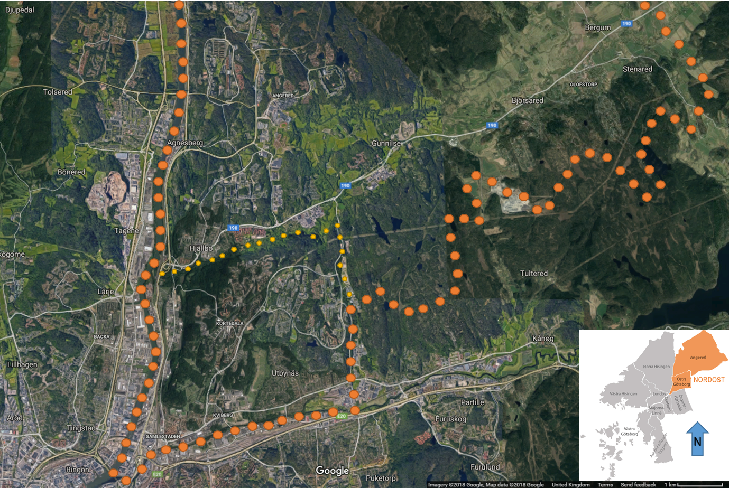
Background - Welcome to Gothenburg NorthEast
Physical isolation, remnant of “miljonprogrammet” ideas of spatial organization

Slide 4
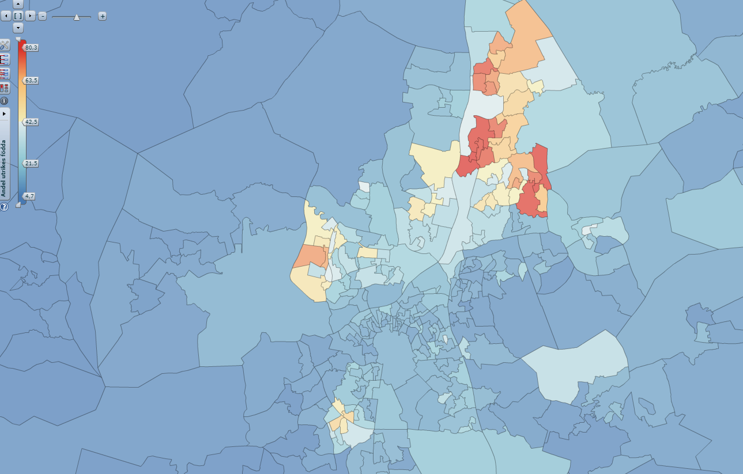
Background - Welcome to Gothenburg NorthEast
Physical isolation, remnant of “miljonprogrammet” ideas of spatial organization
Large degree of ethnic diversity within the population
Proportion of individuals not born in Sweden (blue – low / red – high)

Slide 5
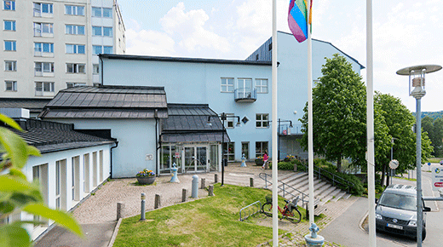
Background - Welcome to Gothenburg NorthEast
Physical isolation, remnant of “miljonprogrammet” ideas of spatial organization
Large degree of ethnic diversity within the population
High unemployment rate / high degree of social welfare

Slide 6
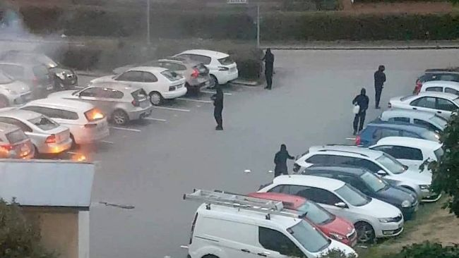
Background - Welcome to Gothenburg NorthEast
Physical isolation, remnant of “miljonprogrammet” ideas of spatial organization
Large degree of ethnic diversity within the population
High unemployment rate / high degree of social welfare
High crime rates / gang activity

Slide 7
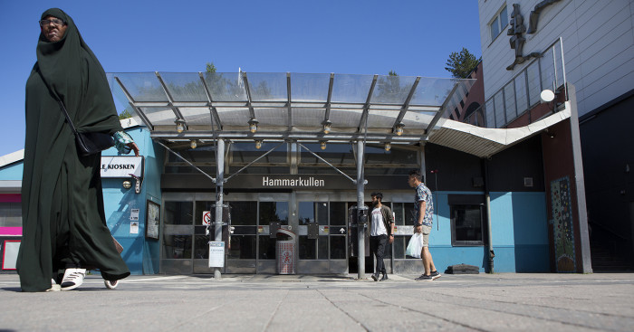
Background - Welcome to Gothenburg NorthEast
Physical isolation, remnant of “miljonprogrammet” ideas of spatial organization
Large degree of ethnic diversity within the population
High unemployment rate / high degree of social welfare
High crime rates / gang activity
Lower medium income than the Gothenburg average

Slide 8
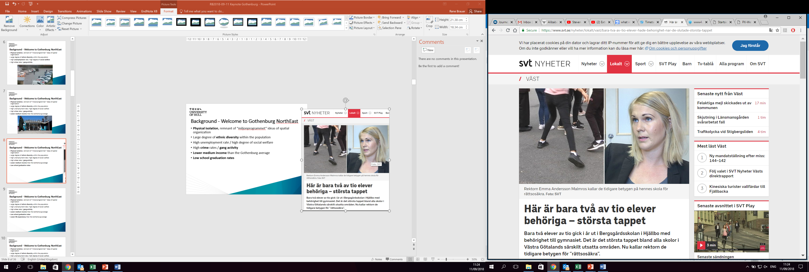
Background - Welcome to Gothenburg NorthEast
Physical isolation, remnant of “miljonprogrammet” ideas of spatial organization
Large degree of ethnic diversity within the population
High unemployment rate / high degree of social welfare
High crime rates / gang activity
Lower medium income than the Gothenburg average
Low school graduation rates

Slide 9
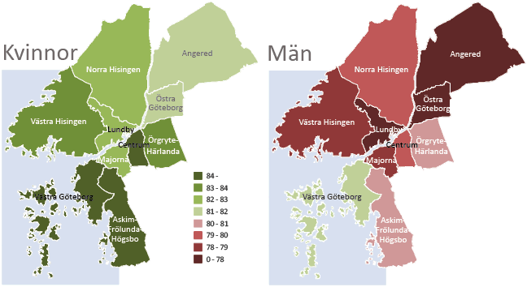
Background - Welcome to Gothenburg NorthEast
Physical isolation, remnant of “miljonprogrammet” ideas of spatial organization
Large degree of ethnic diversity within the population
High unemployment rate / high degree of social welfare
High crime rates / gang activity
Lower medium income than the Gothenburg average
Low school graduation rates
Lower life expectancy than the Gothenburg average

Slide 10
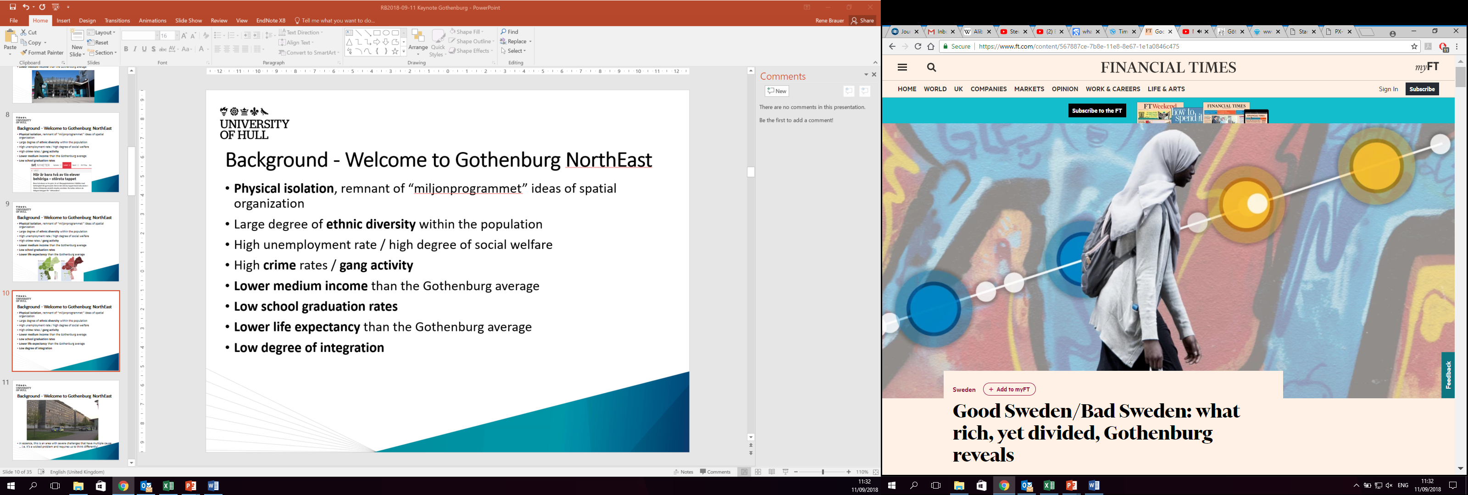
Background - Welcome to Gothenburg NorthEast
Physical isolation, remnant of “miljonprogrammet” ideas of spatial organization
Large degree of ethnic diversity within the population
High unemployment rate / high degree of social welfare
High crime rates / gang activity
Lower medium income than the Gothenburg average
Low school graduation rates
Lower life expectancy than the Gothenburg average
Low degree of integration

Slide 11
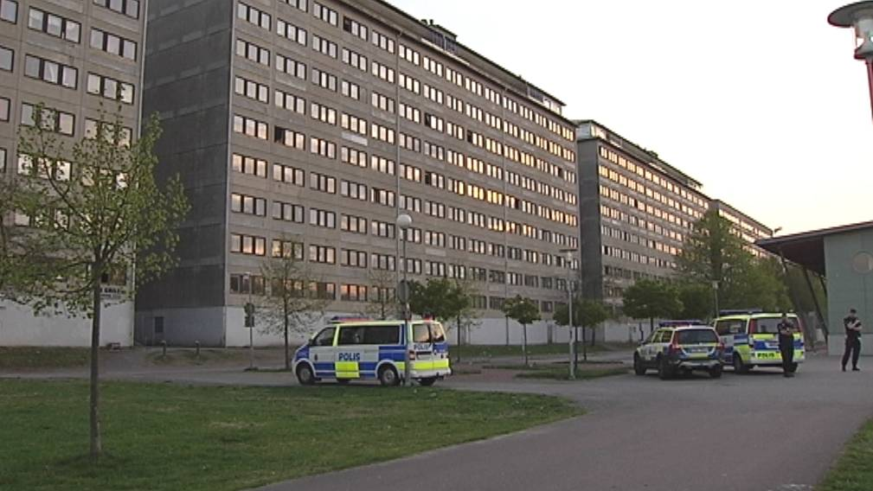
Background - Welcome to Gothenburg NorthEast
In essence, this is an area with severe challenges that have multiple causes … i.e. it’s a wicked problem and requires us to think differently!

Slide 12
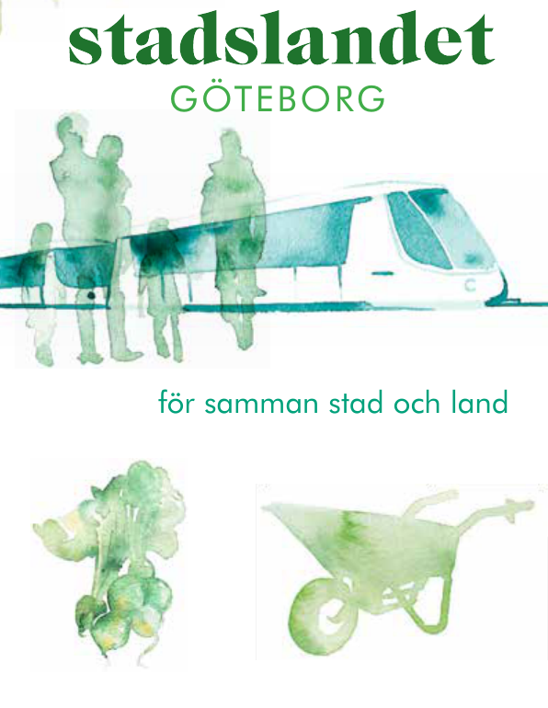

Background – Timeline of the controversy
Development Northeast (“Utveckling Nordost 2011-01-01 – 2013-12-31)
  Financed by City of Gothenburg and EU
  Four different thematic areas:
    Culture
    urban milieu
    vision & communication
    job market
  Initiated pilot study “Stadslandet”
Notes:
Fem focus av stadslandet
Tar bort

Slide 13
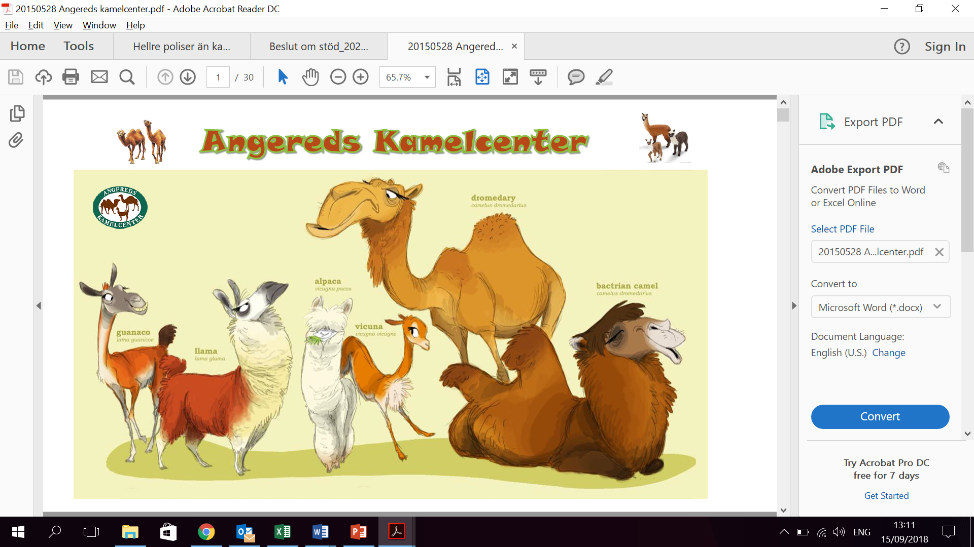
Background – Timeline of the controversy
Angered’s Camel centre (2013-01-01 – 2018-05-30 declared bankruptcy)
  Attempt to establish a Camel farm in Angered
  Four different thematic themes:
    Camel park
    Tourism & event;
    Production & sales;
    Information, research & education
  Financed by a grant from the City of Gothenburg
  Defaulted on repaying the 500k SEK grant
Notes:
Fem focus av stadslandet
Tar bort

Slide 14
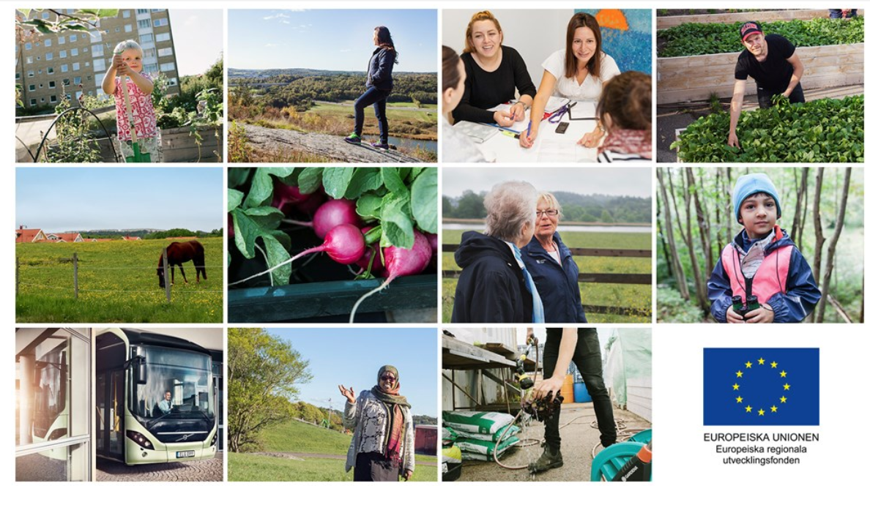
Background – Timeline of the controversy
Urban Rural Gothenburg (“Stadslandet” 2017-01-01 – 2020-04-30)
  Financed from the European regional development fund and Swedish government
  Five different thematic areas:
    Applied food strategy for Gothenburg
    Ecologically and locally produced food in public kitchens
    Climate-smart logistics and electric transport vehicles
    Hotels, markets and restaurants in new business models
    Ecosystem-based tourism development
  Accepted on 2016-12-14
Notes:
Fem focus av stadslandet
Tar bort

Slide 15
Background – Timeline of the controversy
Development Northeast
Urban Rural Gothenburg
(“Stadslandet”)
Pilot project “Stadslandet”
Angered’s Camel centre
2011
2012
2013
2014
2015
2016
2017
2018
2019
2020
+
+
+
-
+
+
“Positive/neutral” publication
-
Critical publication

Slide 16
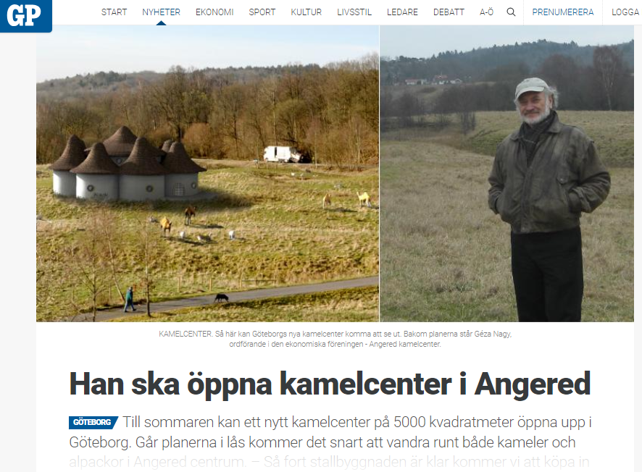
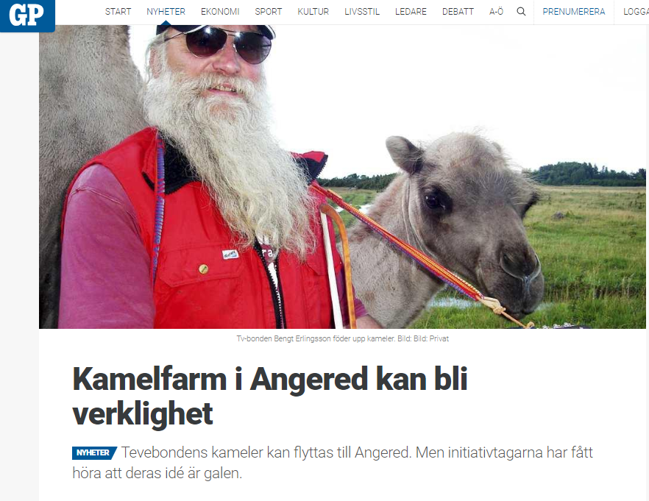
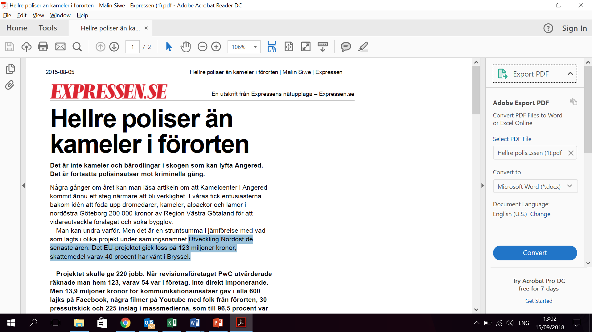
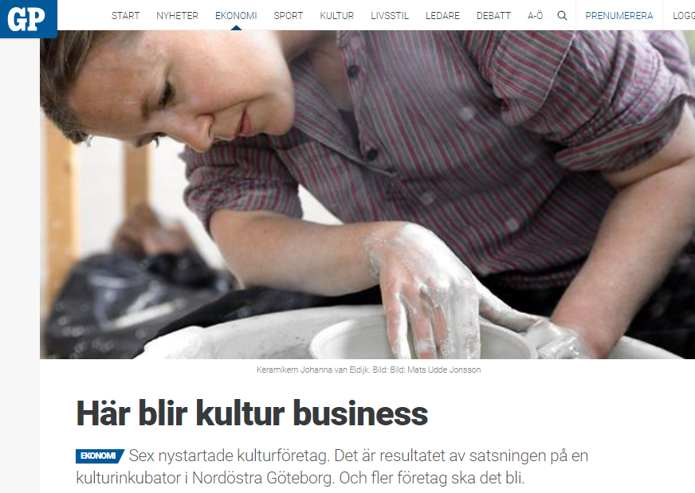
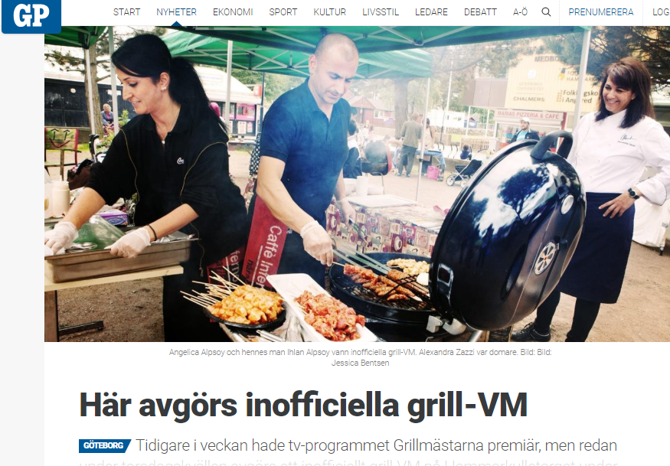
Prior to the controversy

Slide 17
Background – Timeline of the controversy
Development Northeast
Urban Rural Gothenburg
(“Stadslandet”)
Pilot project “Stadslandet”
Angered’s Camel centre
2011
2012
2013
2014
2015
2016
2017
2018
2019
2020
+
+
+
+
-
+
-
-
-
-
-
“Positive/neutral” publication
CONTROVERSY STARTS
+
-
Critical publication

Slide 18
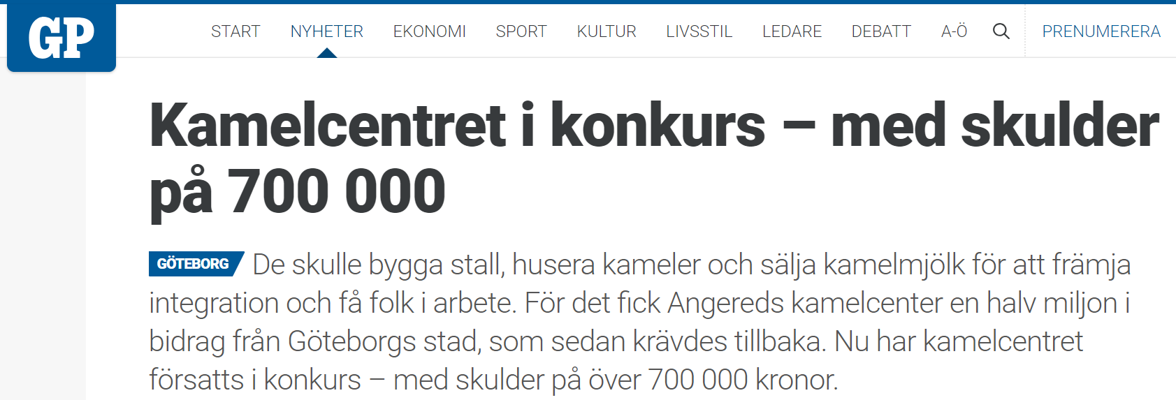
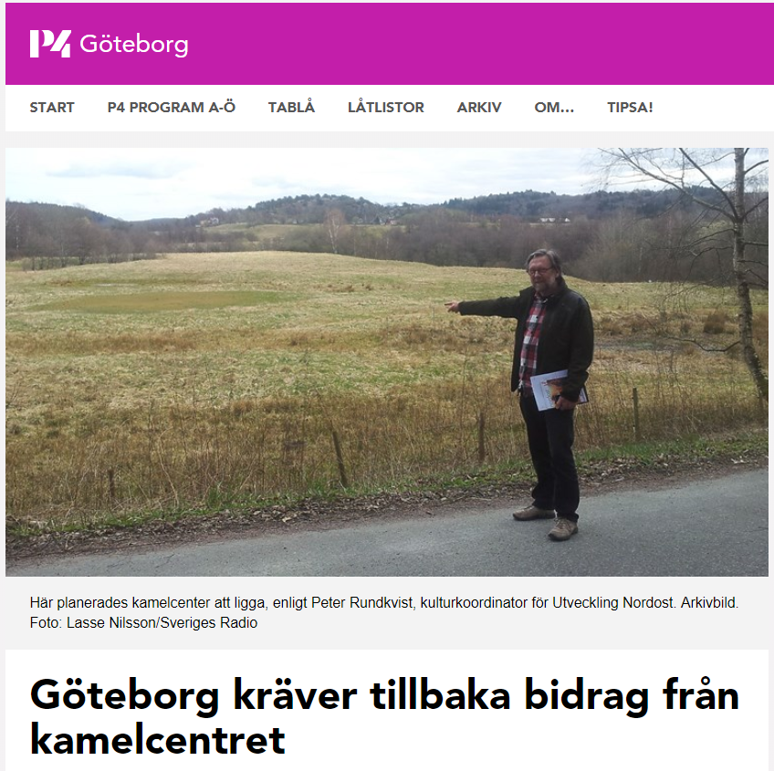
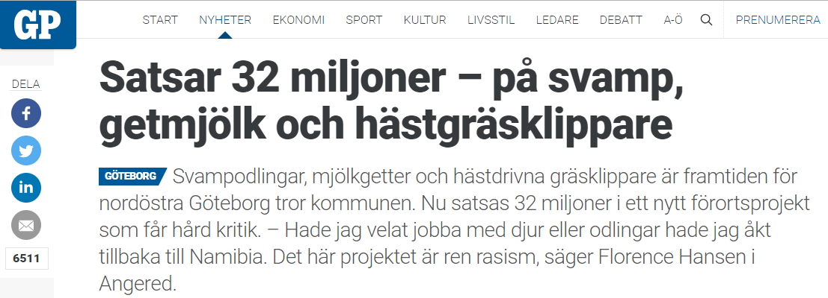
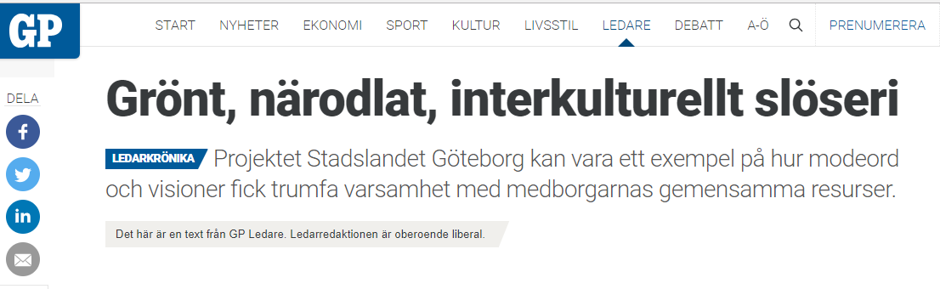
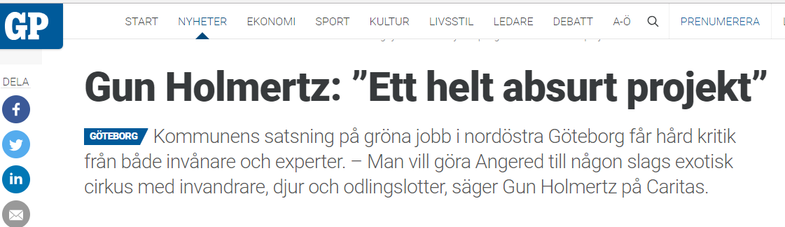
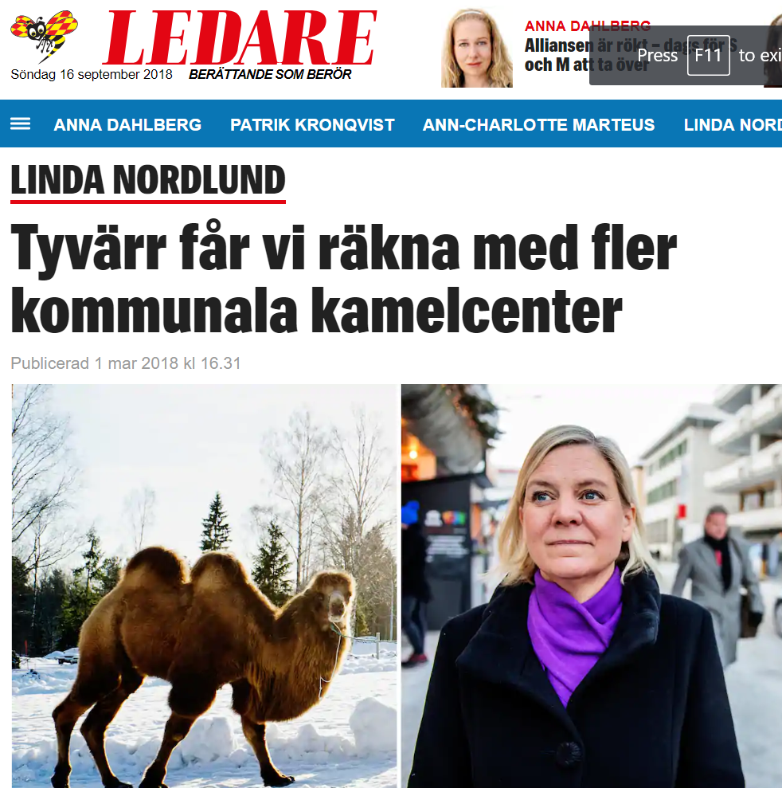
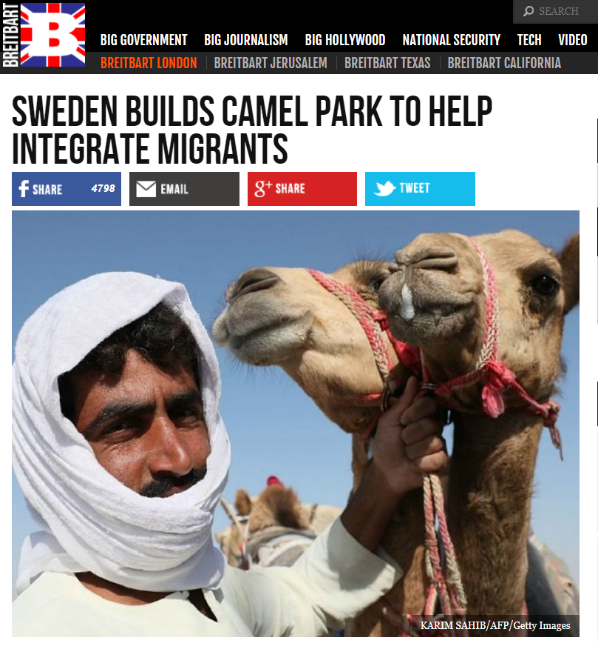
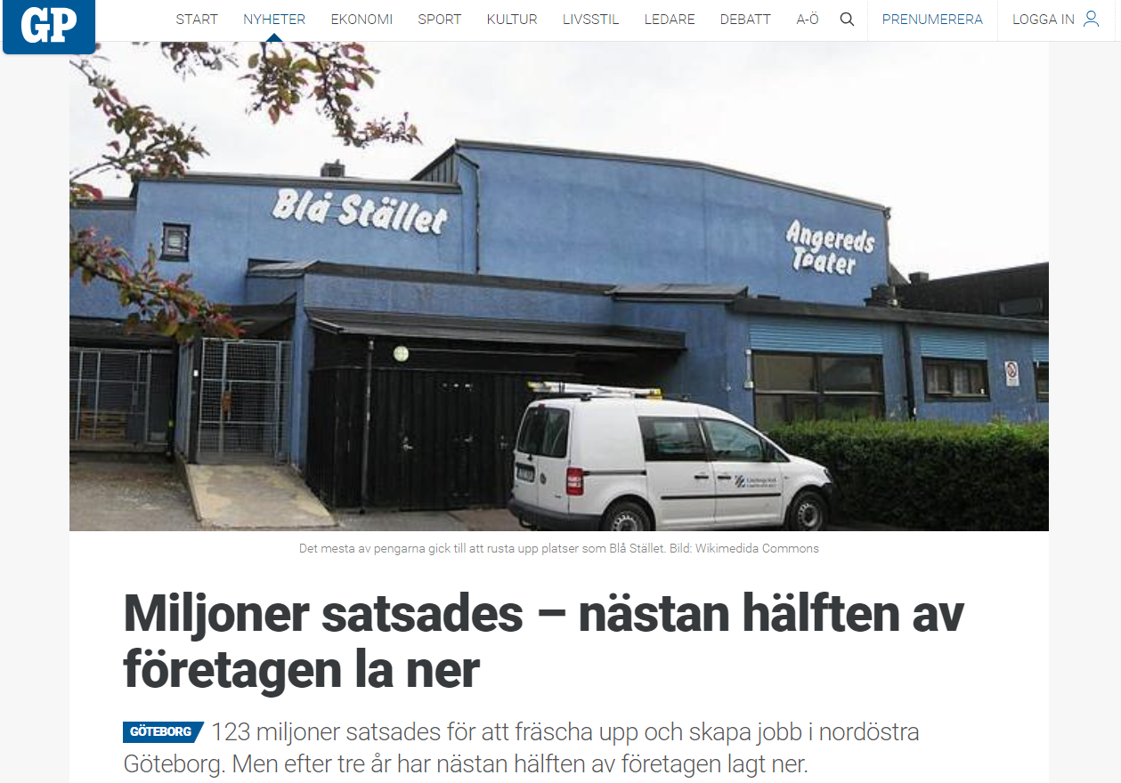
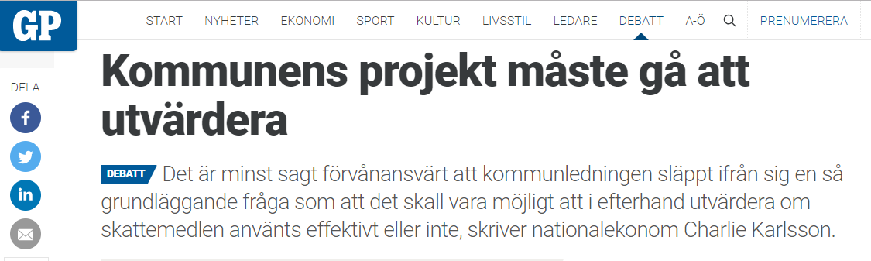
The controversy

Slide 19
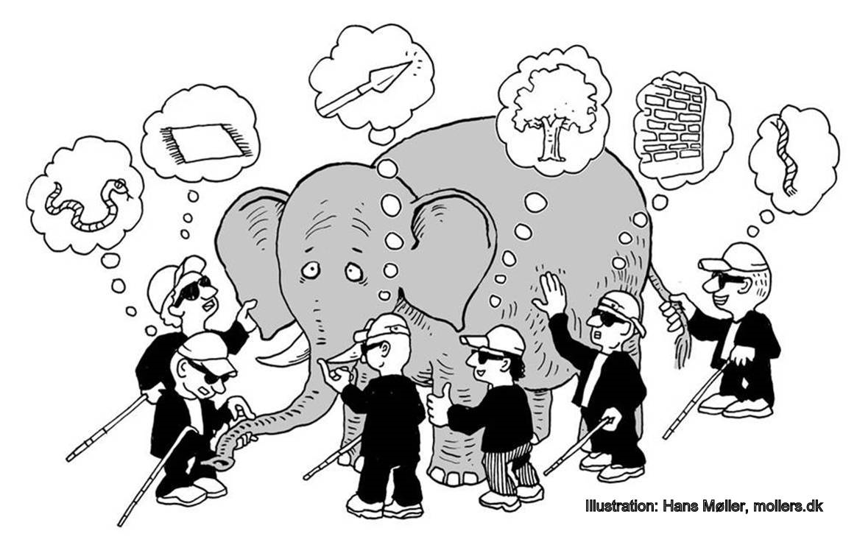
Theory – How concepts influence reality
Presuppositions colour understanding

Slide 20
Theory – How concepts influence reality
Presuppositions colour understanding

Slide 21

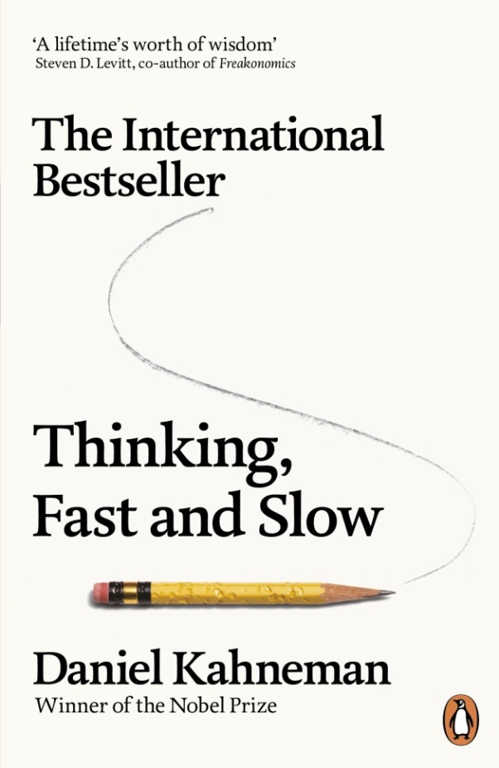

Theory – How concepts influence reality
Presuppositions color understanding
Psychology and human universals (tribalism, biases, logical fallacies, etc.)

Slide 22
Theory – How concepts influence reality
Presuppositions color understanding
Psychology and human universals (tribalism, biases, logical fallacies, etc.)
  Pinker, S. (2003). The blank slate: The modern denial of human nature. Penguin.
  Kahneman, D. (2011). Thinking, Fast and Slow. Penguin.
  Haidt, J. (2012). The righteous mind: Why good people are divided by politics and religion. Penguin.
Sociology of Science offers a similar picture
  “Neo-Marxists discover world systems, or uneven developments, or they theorise regulations. Foucauldians discover systems of governmentality. Communitarians discover communities and the need for informal association and responsibility. Feminists discover glass ceilings, cultural sexism, or gendering assumptions built into scientific and social science method” (Law, 2004:5–6)

Slide 23
Theory – How concepts influence reality
Presuppositions color understanding
Psychology and human universals (tribalism, biases, logical fallacies, etc.)
  Pinker, S. (2003); Kahneman, D. (2011); Haidt, J. (2012)
Sociology of Science offers a similar picture
  Law, J. (2004)
Philosophy also agrees with such an understanding
  “Because we have for millenia made moral, aesthetic, religious demands on the world, looked upon it with blind desire, passion or fear, and abandoned ourselves to the bad habits of illogical thinking, this world has gradually become so marvelously variegated, frightful, meaningful, soulful, it has acquired color - but we have been the colorists: it is the human intellect that has made appearances appear and transported its erroneous basic conceptions into things.” (Nietzsche [1878] 1996:16)

Slide 24
Theory – How concepts influence reality
Presuppositions color understanding
Psychology and human universals (tribalism, biases, logical fallacies, etc.)
  Pinker, S. (2003). The blank slate: The modern denial of human nature. Penguin.
  Kahneman, D. (2011). Thinking, Fast and Slow. Penguin.
  Haidt, J. (2012). The righteous mind: Why good people are divided by politics and religion. Penguin.
Sociology of Science offers a similar picture
  Law, J. (2004). After method: Mess in social science research, Routledge.
Philosophy also agrees with such an understanding
  Nietzsche, F. (1996). Nietzsche: Human, all too human: A book for free spirits. University Press.
A sociological model of the scientific method

Slide 25
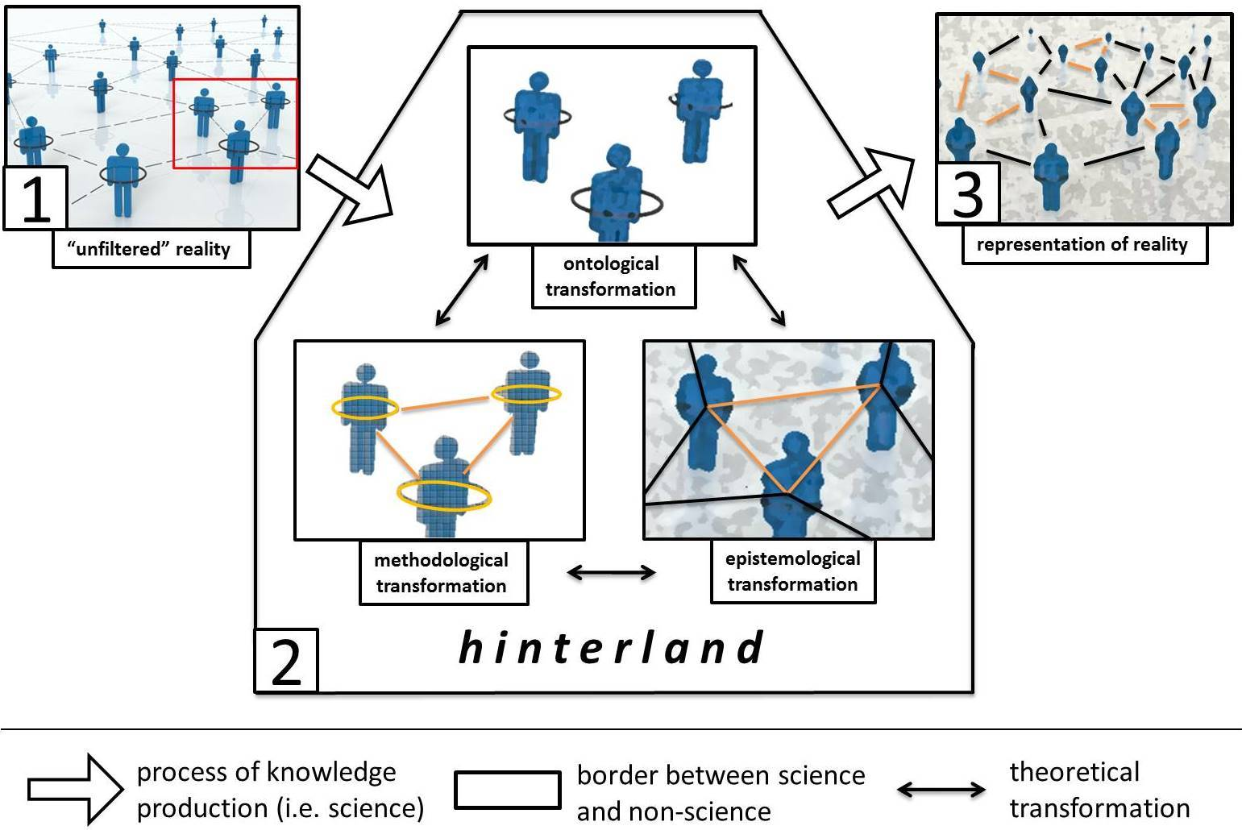
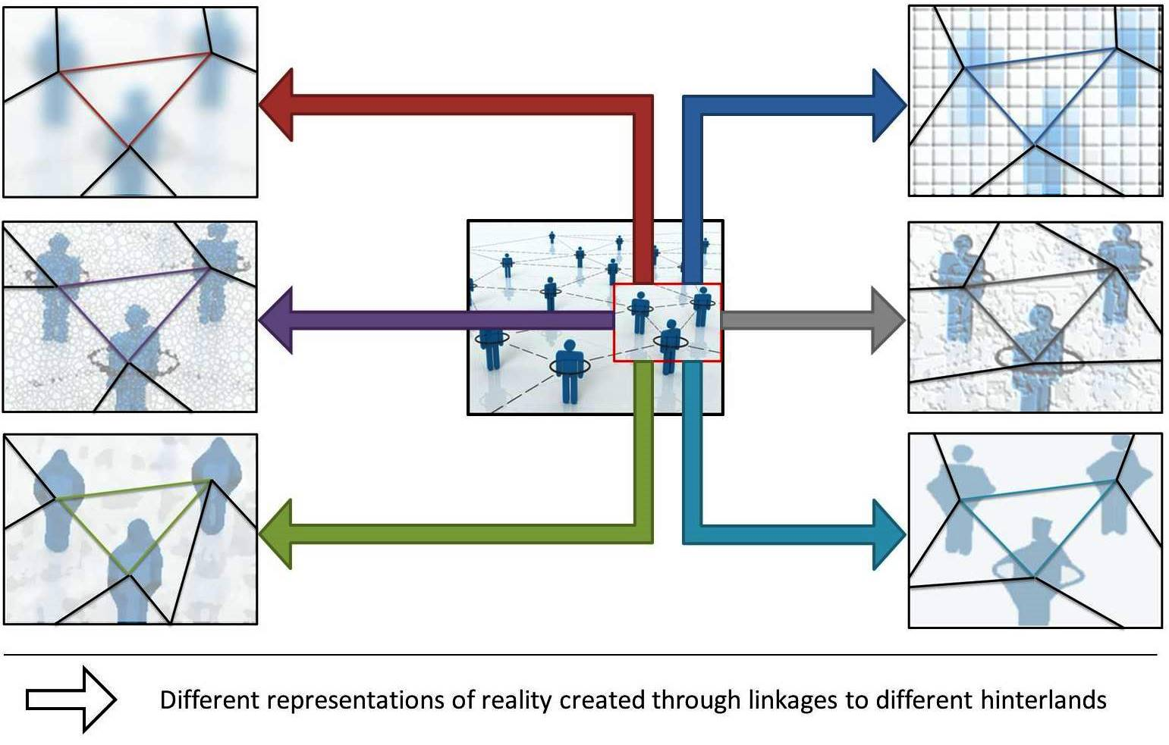
Theory – a sociological model of the scientific method
Individual process Collective consequence
Brauer, R. (2018). What research impact?: tourism and the changing UK research ecosystem (University of Surrey).
Let’s now explore the implications of this process in the NorthEast controversy

Slide 26
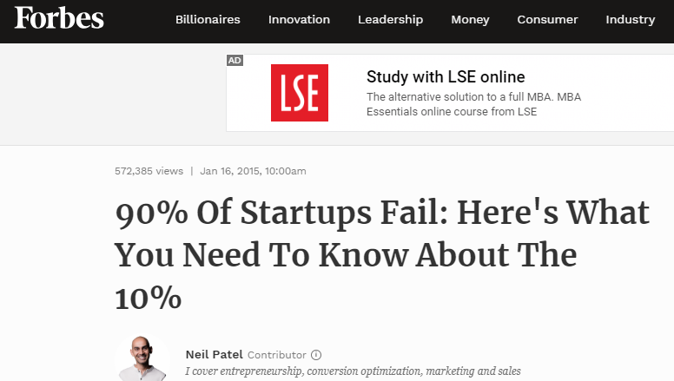
Example 1: Failure to contextualise success
Claim 1: “Millions were invested - almost half of the companies closed down”
Claim 2: “On average 66% of all newly established companies survive three years. In this case it is 56% … we see this as good result”
Controversy: Are they talking about the same success?

Slide 27
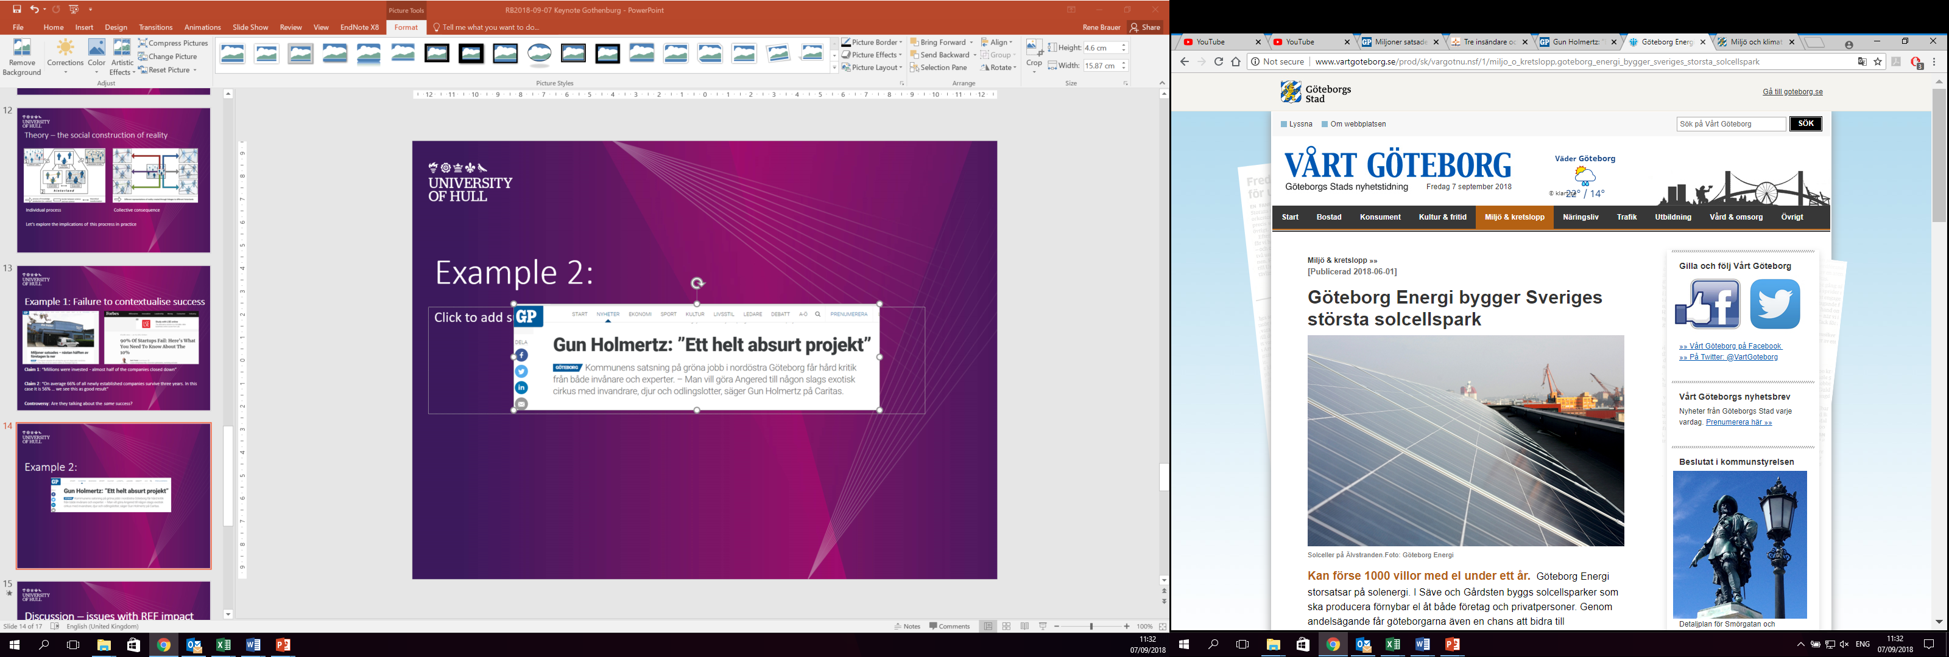
Example 2: Failure to articulate sustainability
Claim 1: Environmental/
ecological focus is laughable
Claim 2: Environmental/
ecological focus is the
future for Gothenburg
Controversy: How to
best achieve sustainability?

Slide 28
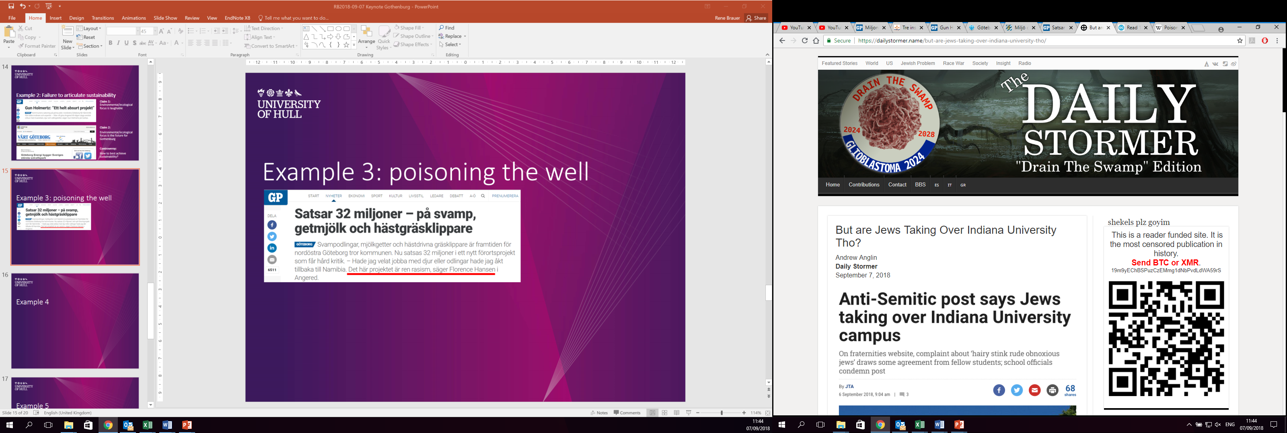
Example 3: poisoning the well
Claim 1: [introduction of labels
before evidence is presented]
Claim 2: [introduction of labels
before evidence is presented]
Controversy: The power lies in the accusation, not in the actual intention of the individual being accused

Slide 29
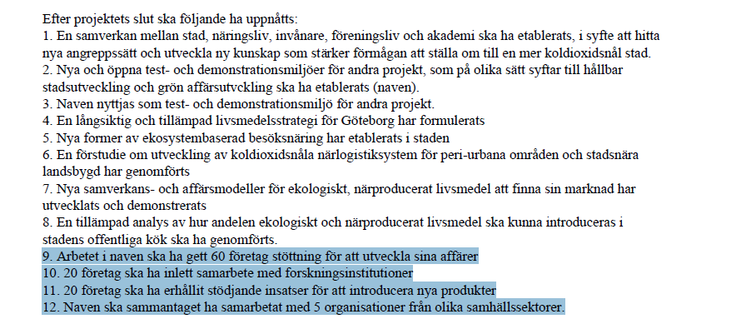
Example 4: “factual” disagreement
Claim 1: impossible to evaluate the effectiveness
Claim 2: The 12 goals set from project application of Stadslandet
Controversy: What metrics should be used to evaluate?

Slide 30
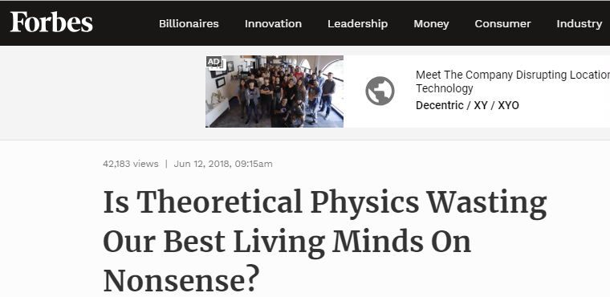
Example 5: “Argumentum ad populum”
Claim 1: “useless intellectual exercise”
Claim 2: “useless intellectual exercise”
Controversy: Why have specialists in the first place?

Slide 31
Discussion – how to avoid talking past each other
Criticism is easy, creation is difficult, similarly:
  “Since social (and natural) science investigations interfere with the world […]. Things change as a result. The issue, then, is not to seek disengagement but rather with how to engage. It is about how to make good differences in circumstances where reality is both unknowable and generative” (Law 2004:7)
The process of construction is what makes something “scientific”
  Ideal speech situation (Habermas 1990)
Inspiration from the peer review process
  Part of the peer group (i.e. common knowledge base)
  Are the manners of discussion agreed? (e.g. public record of debate)
  Ability to skilfully communicate (e.g. fluency in a common language)
  Same goals
  A common ethos (e.g. similar values)
    E.g. to argue in good faith, because:
  “What if everything in the world were a misunderstanding, what if
  laughter were really tears?” Soren Kierkegaard (1813-1855)

Slide 32
Conclusion: Addressing wicked problems “scientifically”
NorthEast of Gothenburg is an area characterised by wicked problems
  Kaleidoscope of interpretation, people project meaning upon reality
  The lowest common denominator should be to avoid wicked (Iatrogenic) solutions
Disagreement is a natural part of human social interaction
  We are often inclined to simplifications and miss-characterisation
  Common language is paramount in avoiding tribalism
The “scientific” approach offers a potential avenue to address wicked problems
  This presupposes common knowledge, manners, skill, purpose and ethos
  In case of disagreement, you then can reinforce and defend these values

Slide 33
Thank you for listening
References can be distributed by request (r.brauer@hull.ac.uk)

