Slide 1
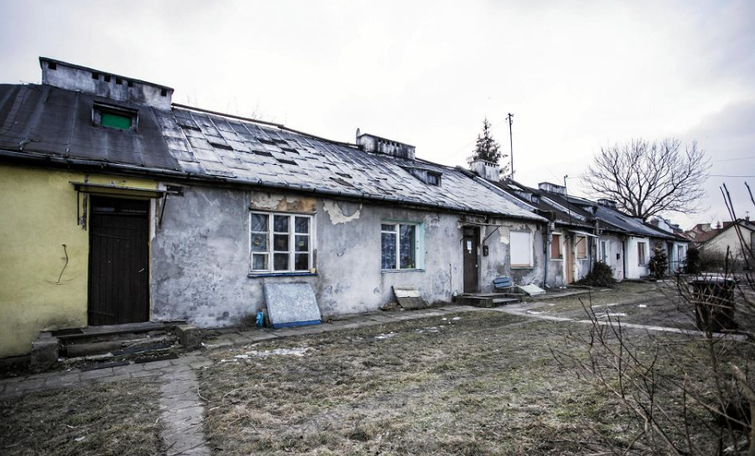
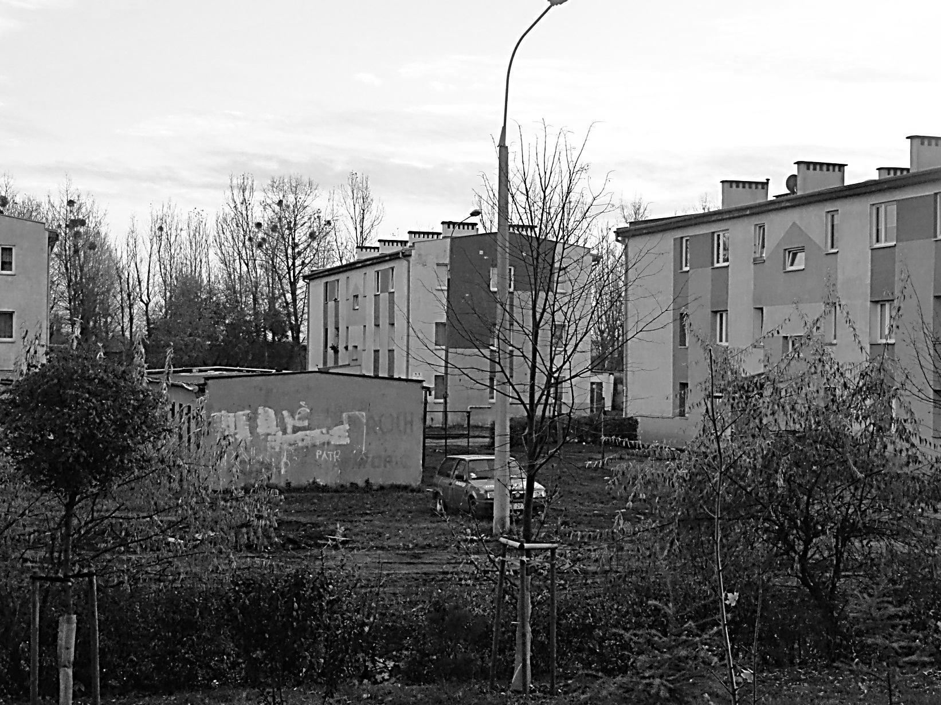
Jadwiga Biegańska, PhD jadwigab@umk.pl
Dysfunctionality vs. urban-rural solutions: Can it work?
Mistra Urban Futures
“Wicked problems or wicked solutions? Sustainability–differently” Gothenburg, Sweden, 18th of September 2018

Slide 2
Dysfunctionality vs. urban-rural solutions: Can it work?
Mistra Urban Futures , Urban Research Seminar, “Wicked problems or wicked solutions? Sustainability–differently”
1. Introduction
2. Background, problem & aim
3. Theoretical framework
4. Research areas
5. Results from field and desk studies
6. Conclusions
7. Final reflection

Slide 3
Dysfunctionality vs. urban-rural solutions: Can it work?
Mistra Urban Futures , Urban Research Seminar, “Wicked problems or wicked solutions? Sustainability–differently”
Introduction
Sustainability = social justice expressed in the environmental, economic and social efficiency of undertaken actions:
the same responsibility;
the equal opportunities.
How does it work at the local scale?
Global perspective
Local perspective

Slide 4
Dysfunctionality vs. urban-rural solutions: Can it work?
Mistra Urban Futures , Urban Research Seminar, “Wicked problems or wicked solutions? Sustainability–differently”
Introduction
gives rise to
social injustice
Rural-urban dichotomy as a source of contention that:
reproduces human suffering
Example:
Poland
dysfunctionality
landscape perception
in certain spatial context
construction of aid programs for people with similar needs
Phenomena:

Slide 5
Dysfunctionality vs. urban-rural solutions: Can it work?
Mistra Urban Futures , Urban Research Seminar, “Wicked problems or wicked solutions? Sustainability–differently”
Background, problem & aim
System transition (1989)
Problem
* Turning point in the history of Poland and Eastern Europe
Formal classification is the main criterion in the aid programs
* Affected both urban and rural areas
* Caused progressive social polarization and equal prevalence of social problems
Aim

Slide 6
Dysfunctionality vs. urban-rural solutions: Can it work?
Mistra Urban Futures , Urban Research Seminar, “Wicked problems or wicked solutions? Sustainability–differently”
Urban vs rural areas in Poland: Formal-legal regulations (limitations?)
Urban areas
Rural areas
Assumption: The problems in the city are more complex (A)
Opportunities to obtain public funds for multidimensional revitalization
* Opportunities to obtain public funds only for modernization
Assumption: It is forbbiden to raise animals for consumption in multi-family blocks of flats in a city (B)
* Total ban on livestock maintenance
* Allowance to maintain livestock
Assumption: There are worse-quality roads in the countryside (C)
* No institution provides students’ transportation to schools
* Students (primary level) are transported to schools
Assumption: The level of education is lower in the countryside (D)
* Teachers in urban schools do not receive extra salary for teaching in urban schools
* Teachers in rural schools receive additional salary
Development Strategy of Kujawsko-Pomorskie 2007-2020 (2005).- A ,
Resolution No. 246/03 of the City Council of Toruń from 2003-10-30 on establishing rules for maintenance and order in the City of Toruń, ch. 6, §27. - B,
Decree from 1991-09-07 on the educational system (Journal of Law of 2004, No. 256, item 2572) - C,
Decree from 1990-03-08 on local government (Journal of Law of 1998, No. 162, item 1126) - D

Slide 7
Dysfunctionality vs. urban-rural solutions: Can it work?
Mistra Urban Futures , Urban Research Seminar, “Wicked problems or wicked solutions? Sustainability–differently”
Main questions
1. What are the real problems of people inhabiting these de iure “rural” and “urban” areas? Are there “rural” and “urban” problems?
2. How do inhabitants perceive rurality and urbanity?
3. Are the aid programs targeting the right needs? Does the fact of formal classification affect the possible aid?

Slide 8
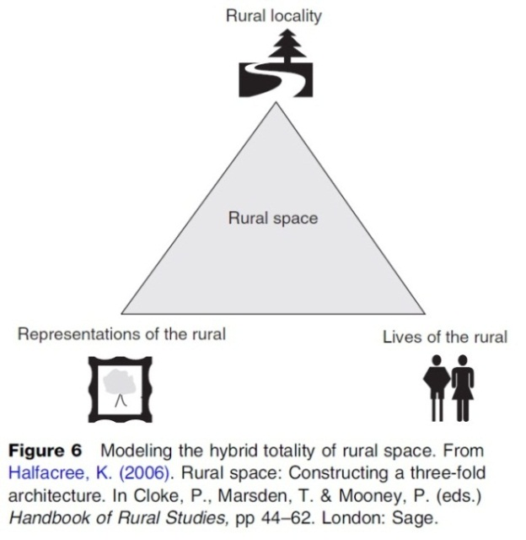
Dysfunctionality vs. urban-rural solutions: Can it work?
Mistra Urban Futures , Urban Research Seminar, “Wicked problems or wicked solutions? Sustainability–differently”
Theoretical framework
‘Rural’ and ‘urban’ as socially produced sets of manifolds
Status of any place (rural or urban) always determined on ‘the ground’ or ‘in place’
First-hand stories of people’s everyday lives as the main representation in understanding spatial concepts
Localities can be: a) congruent and unified; b) contradictory and disjointed; c) chaotic and incoherent (Chotel/Rolnicza)
Halfacree (2006), Rural Space: Constructing a Three-Told Architecture. In: P. CLOKE, T. MARSDEN, & P. H. MOONEY, eds., Handbook of Rural Studies, pp. 44–62. London: Sage.

Slide 9
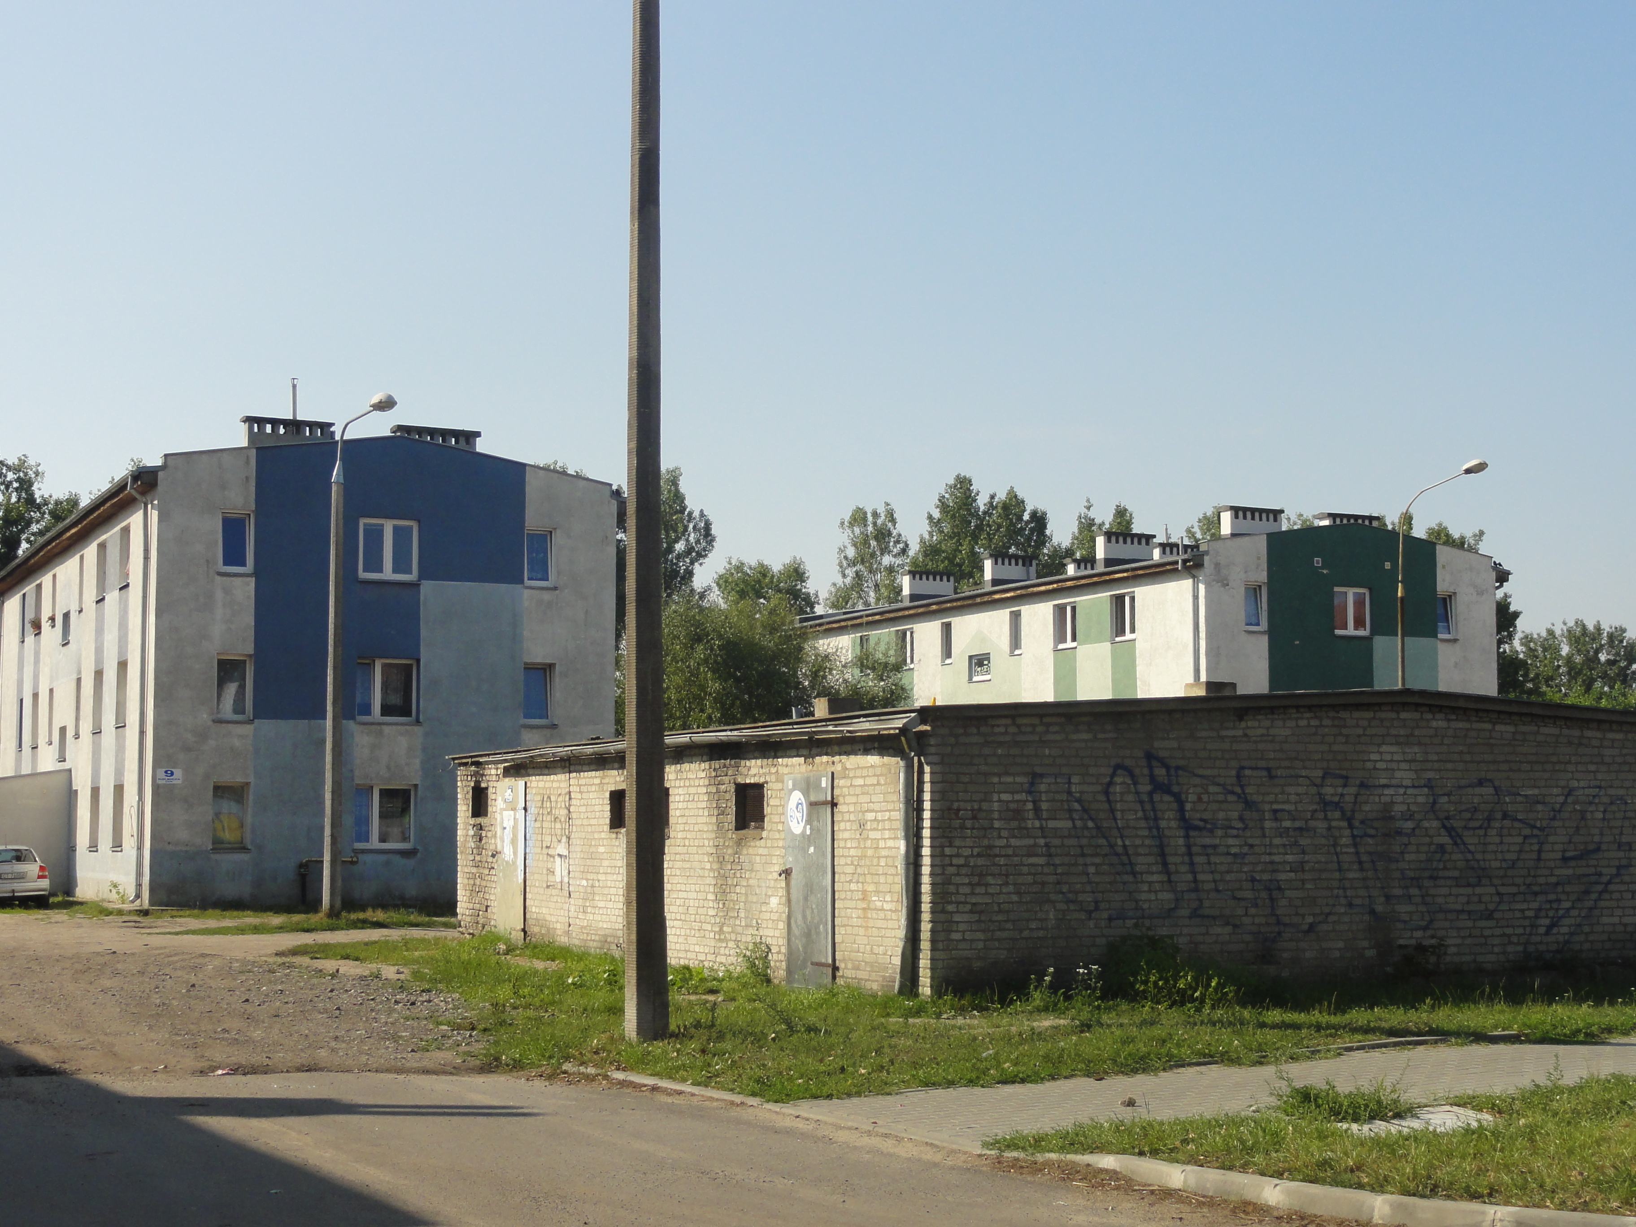
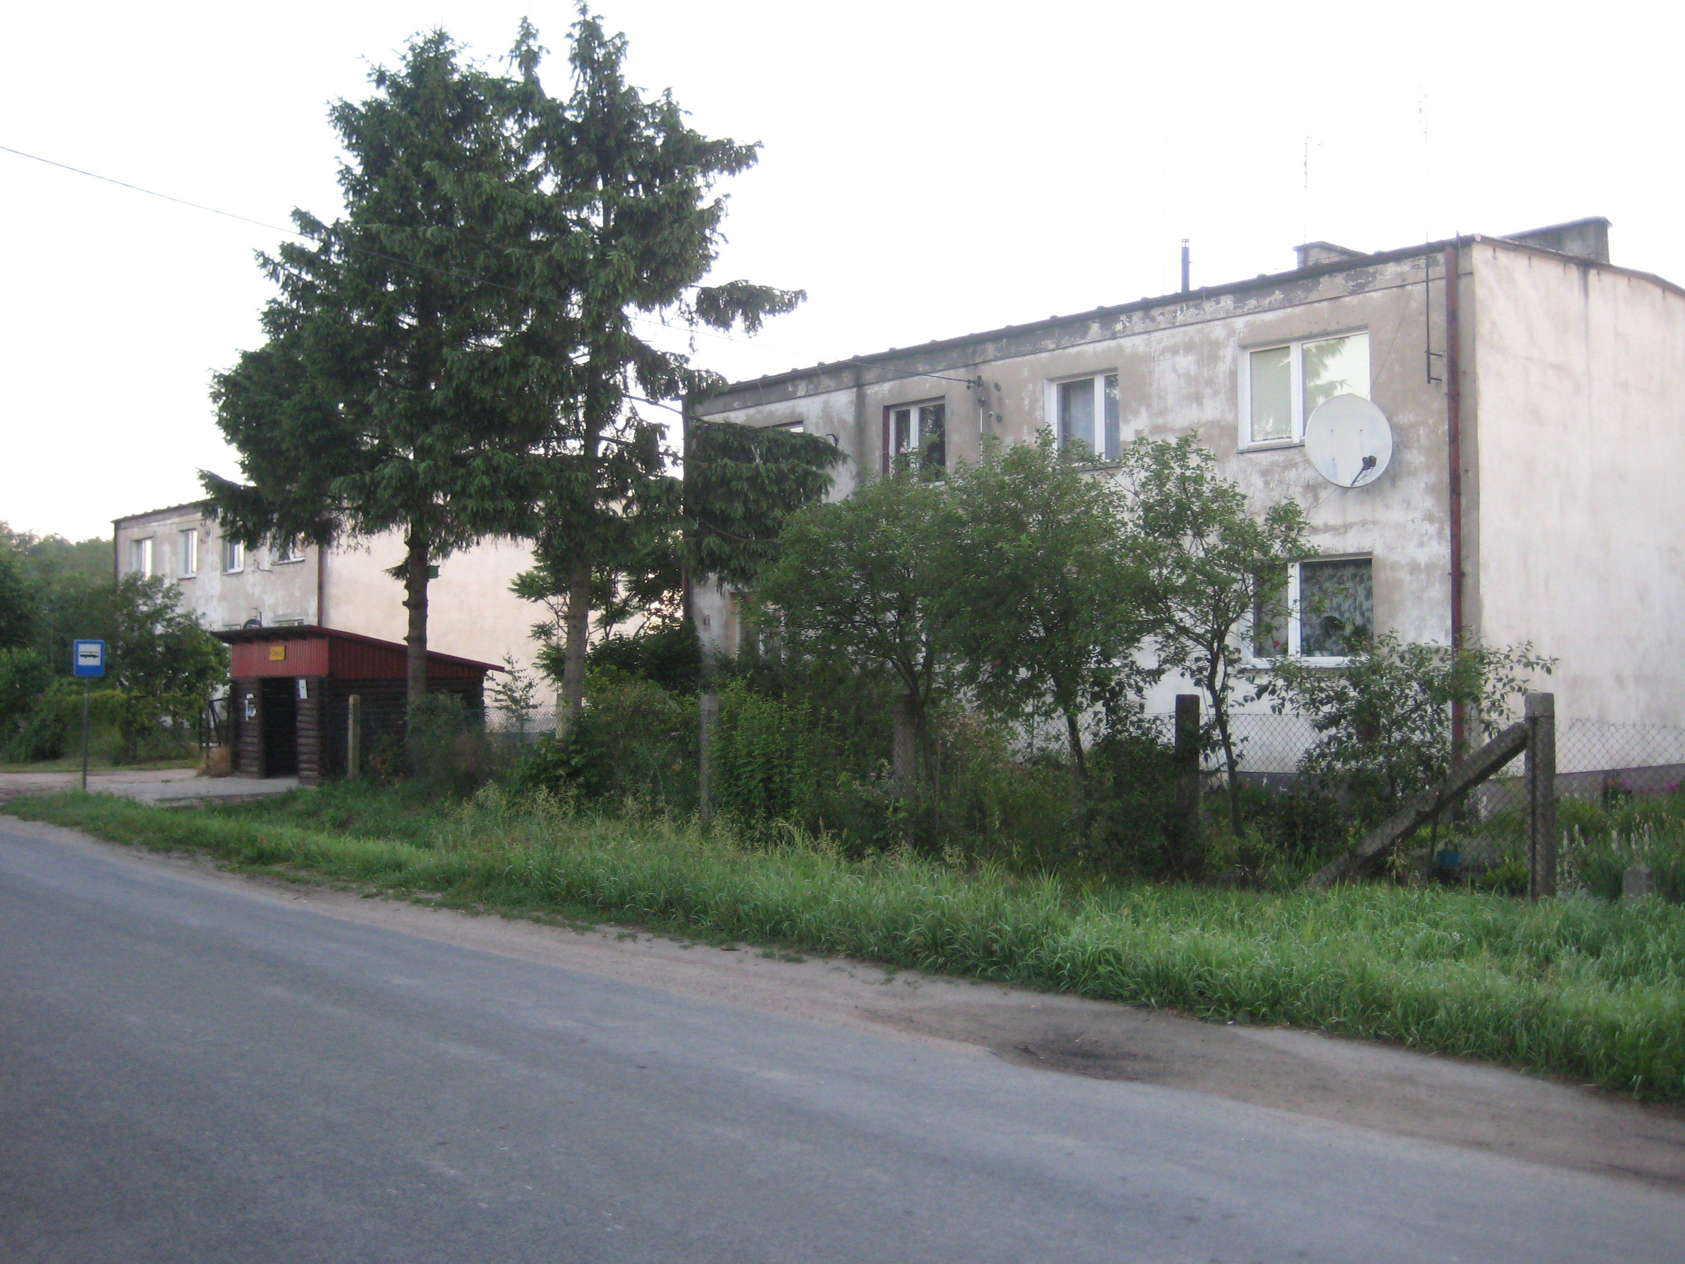
Dysfunctionality vs. urban-rural solutions: Can it work?
Mistra Urban Futures , Urban Research Seminar, “Wicked problems or wicked solutions? Sustainability–differently”
Research areas
Rolnicza
Location: the city of Toruń in Northern Poland
Type of estate: post-military estate
History:
- 1945-1993 – Unit of Soviet Army
- 1993-now - communal flat estate populated by the poor residents
Formal classification: urban
Chotel
Location: the village of Kazanki in Central Poland
Type of estate: post-State Agricultural Farm estate
History:
- 1945-1991 – functioned as State Agricultural Farm (SAF) and the
only employer for residents
- 1991-now - SAF collapsed
Formal classification: rural

Slide 10
Dysfunctionality vs. urban-rural solutions: Can it work?
Mistra Urban Futures , Urban Research Seminar, “Wicked problems or wicked solutions? Sustainability–differently”
Research areas
Similar genotype
Kazanki - Chotel
Toruń -Rolnicza
Similar physical characteristics
Similar social composition

Slide 11
Dysfunctionality vs. urban-rural solutions: Can it work?
Mistra Urban Futures , Urban Research Seminar, “Wicked problems or wicked solutions? Sustainability–differently”
1. What are the real problems of people inhabiting these de iure “rural” and “urban” areas? Are there “rural” and “urban” problems?

Slide 12
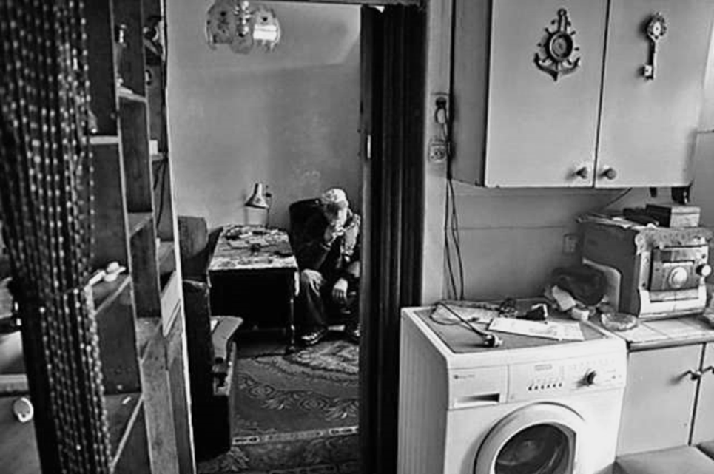
Dysfunctionality vs. urban-rural solutions: Can it work?
Mistra Urban Futures , Urban Research Seminar, “Wicked problems or wicked solutions? Sustainability–differently”
How do you assess your (or your family’s) financial situation?
I had a cow, cultivated beets, potatoes, grain. The SAF provided cheap feed [. . .]
Today it’s tragic, complete poverty.
(Male, Chotel, 50–59)
No work, only stress. The living is so fast. No wonder people reach for something to calm their nerves.
(Female, Rolnicza, 30–39)
Problems: economic dimension (1/3)

Slide 13
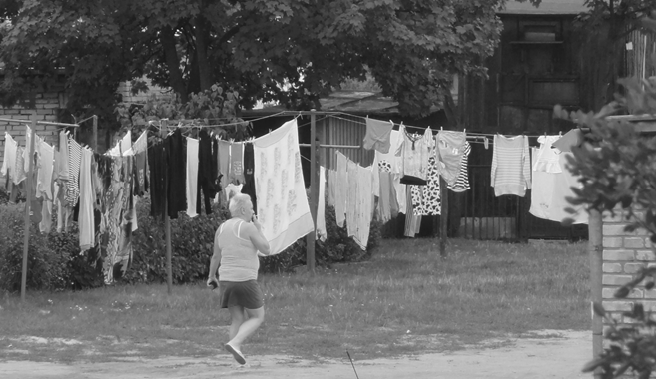
Dysfunctionality vs. urban-rural solutions: Can it work?
Mistra Urban Futures , Urban Research Seminar, “Wicked problems or wicked solutions? Sustainability–differently”
How do you and your family provide for your basic needs?
I had a cow, cultivated beets, potatoes, grain. The SAF provided cheap feed [. . .]
Today it’s tragic, complete poverty.
(Male, Chotel, 50–59)
No work, only stress. The living is so fast. No wonder people reach for something to calm their nerves.
(Female, Rolnicza, 30–39)
Problems: economic dimension (2/3)

Slide 14
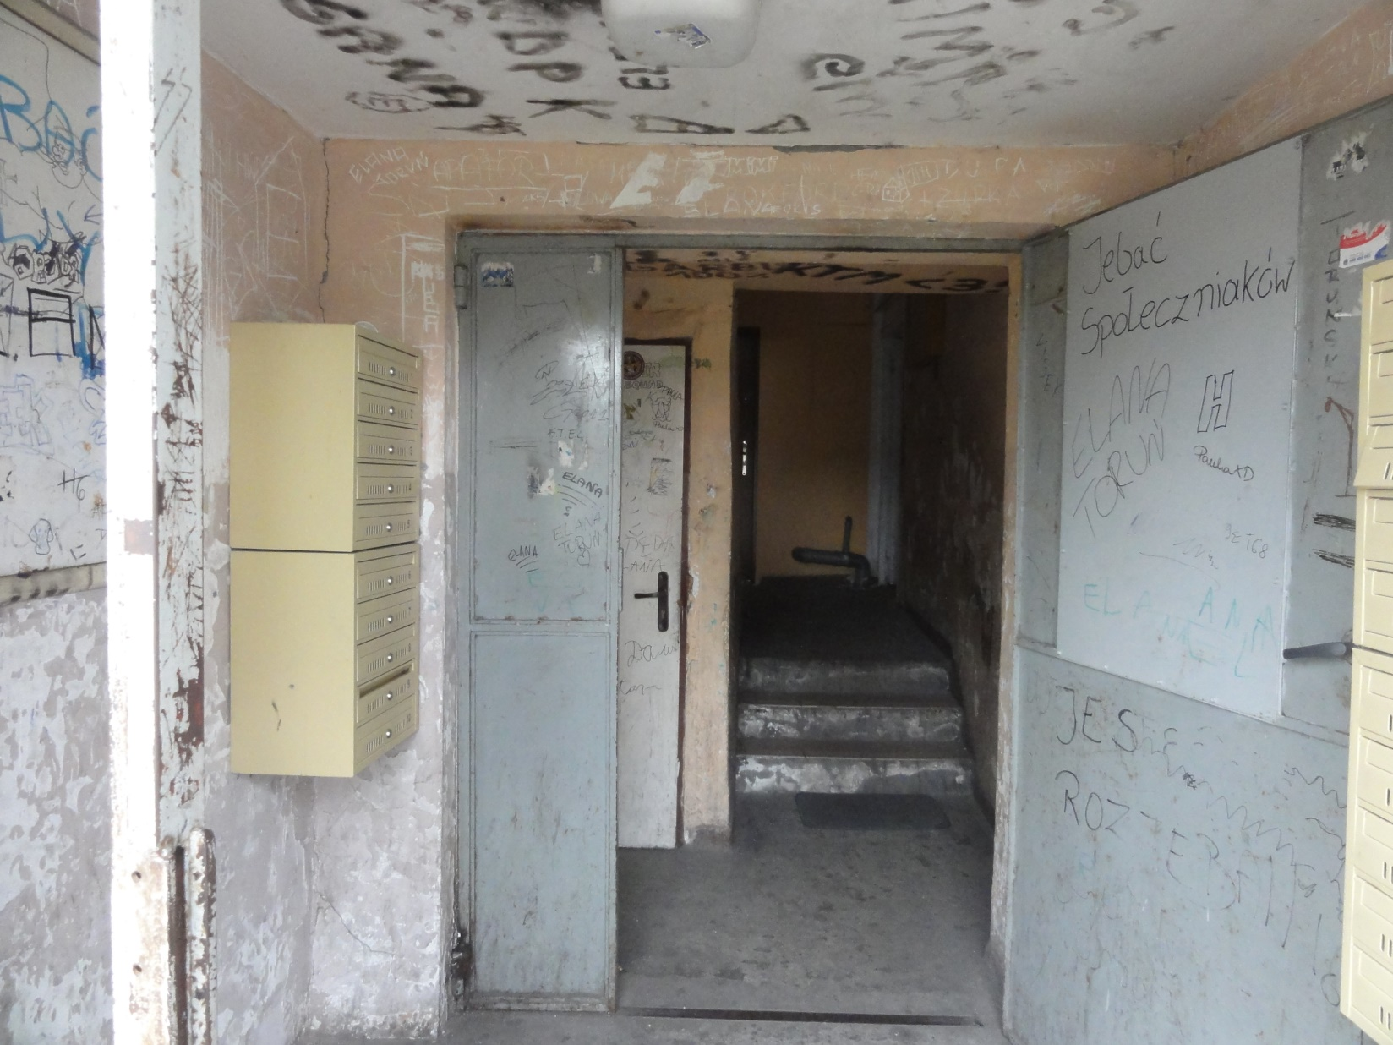
Dysfunctionality vs. urban-rural solutions: Can it work?
Mistra Urban Futures , Urban Research Seminar, “Wicked problems or wicked solutions? Sustainability–differently”
What do you and your family spend your money on?
Rolnicza
Chotel
Problems: economic dimension (3/3)

Slide 15
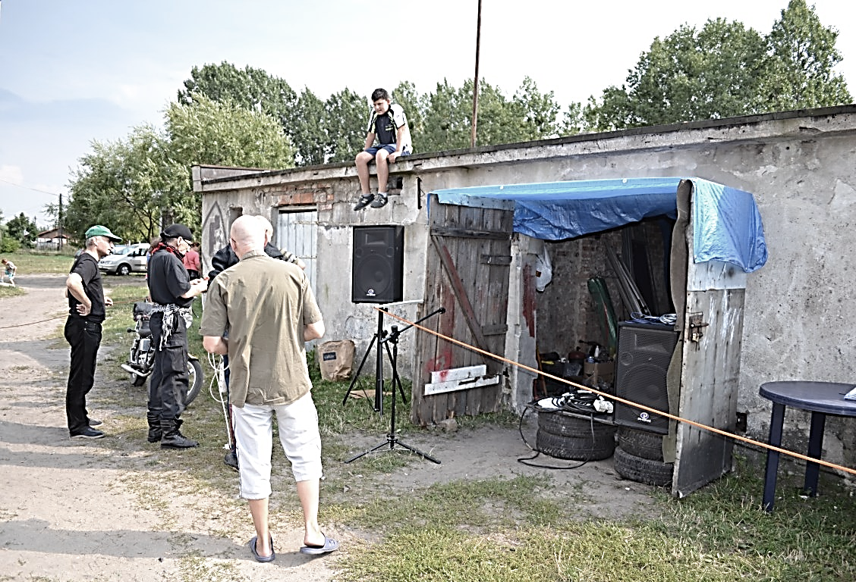
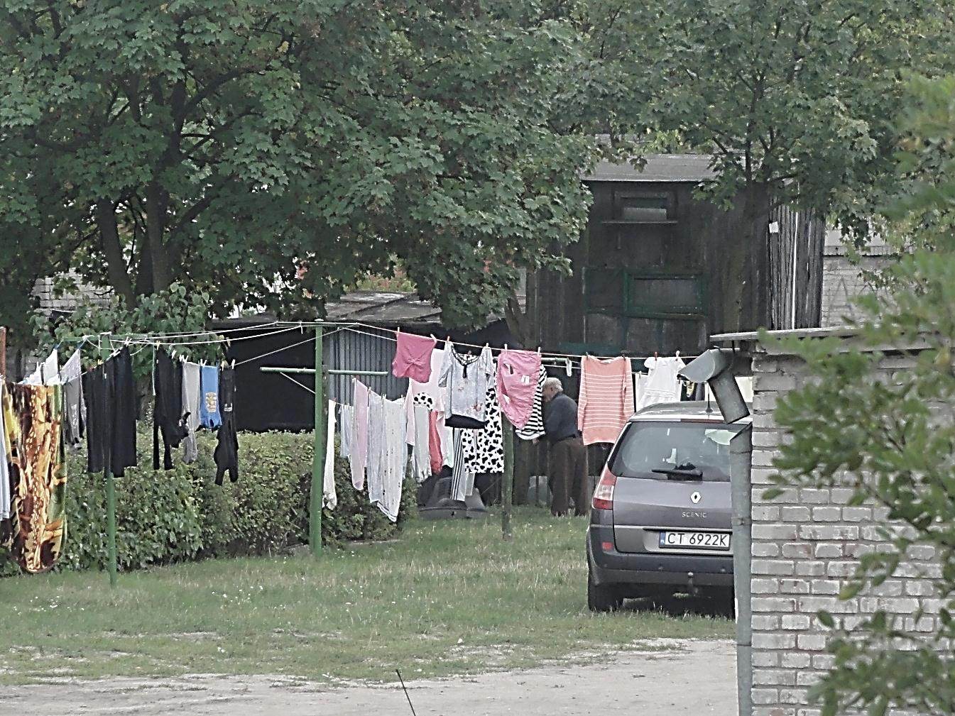

Slide 16
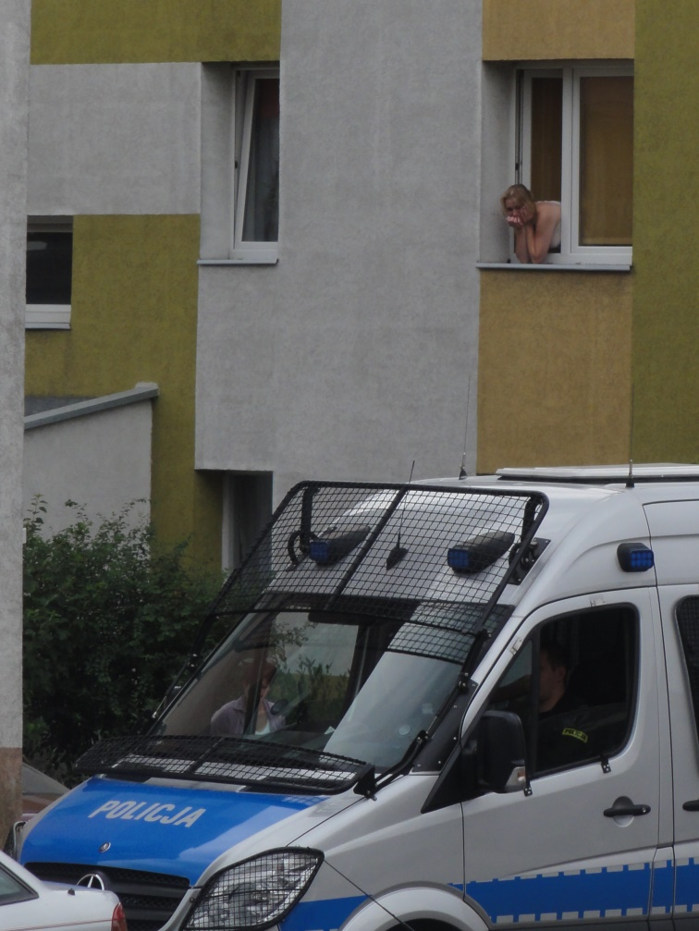
Dysfunctionality vs. urban-rural solutions: Can it work?
Mistra Urban Futures , Urban Research Seminar, “Wicked problems or wicked solutions? Sustainability–differently”
Occurrences of antisocial demeanor:
Problems: social issues (1/2)

Slide 17
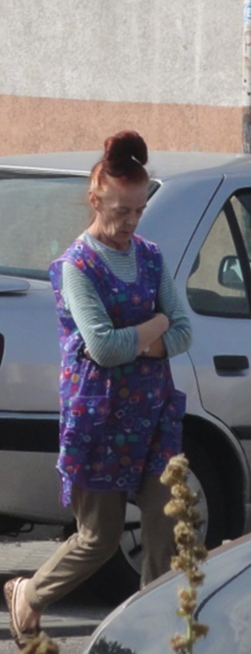
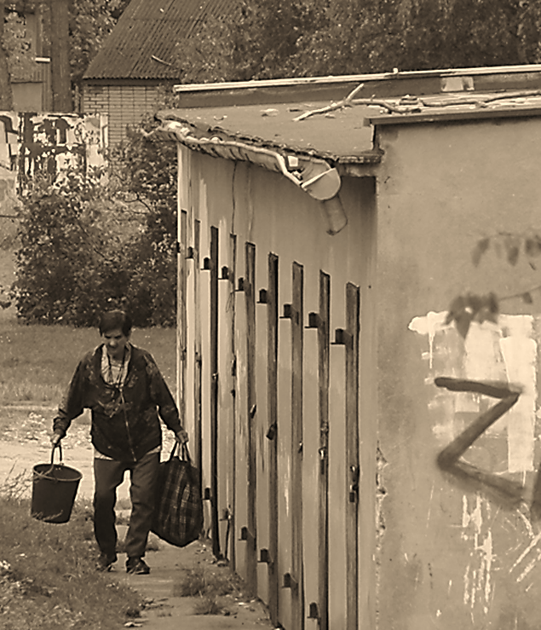
Dysfunctionality vs. urban-rural solutions: Can it work?
Mistra Urban Futures , Urban Research Seminar, “Wicked problems or wicked solutions? Sustainability–differently”
Do you think that your co-residents are in good relations with the residents of the neighbouring settlements?
Close? They would drown one another in a spoonful of water or backstab each other.
Everyone has their own little gate to shut off others. Before, we cooked in one pot [. . .]. We went along. Now, it’s a different story.
(Male, Chotel, 50–59)
The residents are certainly not close. They form small groups [. . .] People are false and deceitful. There’s gossip everywhere.
(Male, Rolnicza, 40–49)
Problems: social issues (2/2)

Slide 18
Dysfunctionality vs. urban-rural solutions: Can it work?
Mistra Urban Futures , Urban Research Seminar, “Wicked problems or wicked solutions? Sustainability–differently”
What do you miss the most in your apartment?
The world moves forward, but here… there’s not even a sidewalk. We have to walk on footbridges, throw planks, jump like monkeys… (Female/Rolnicza/50-59)
Small cubicles, bunk beds, people living like tigers in cages, it’s a crying shame. Piled up in those few square meters, the kids don’t even have to watch web-porn…
(Male, Rolnicza, 50-59)
Once, living in Chotel was like in a city. Today – a sight of despair.
(Female/Chotel/50-60)
Problems: material dimension (1/1)

Slide 19
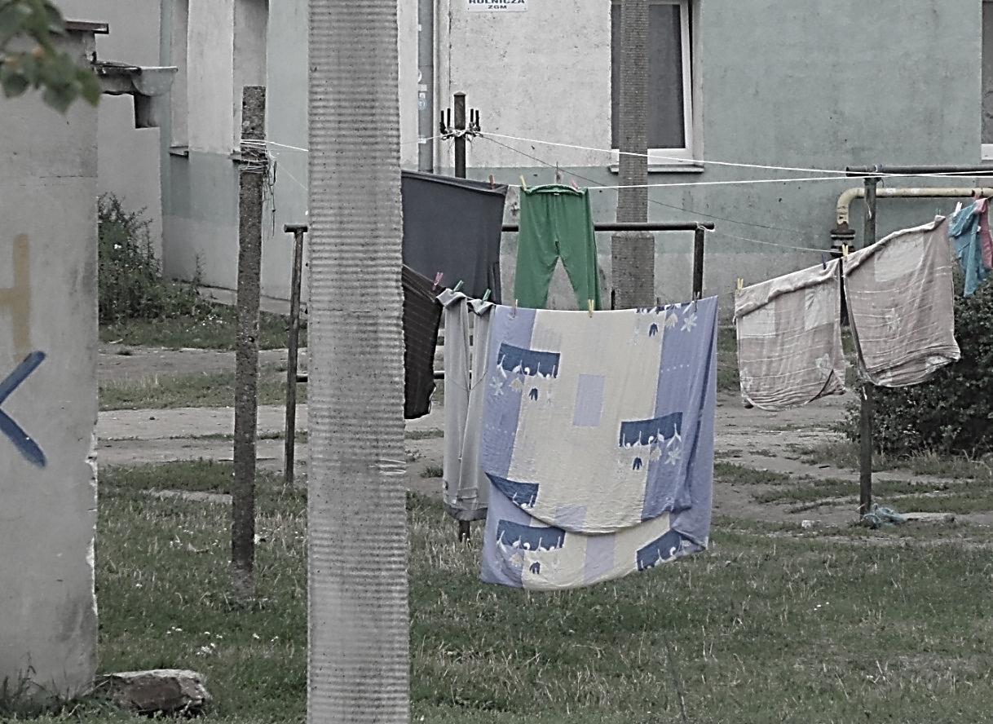
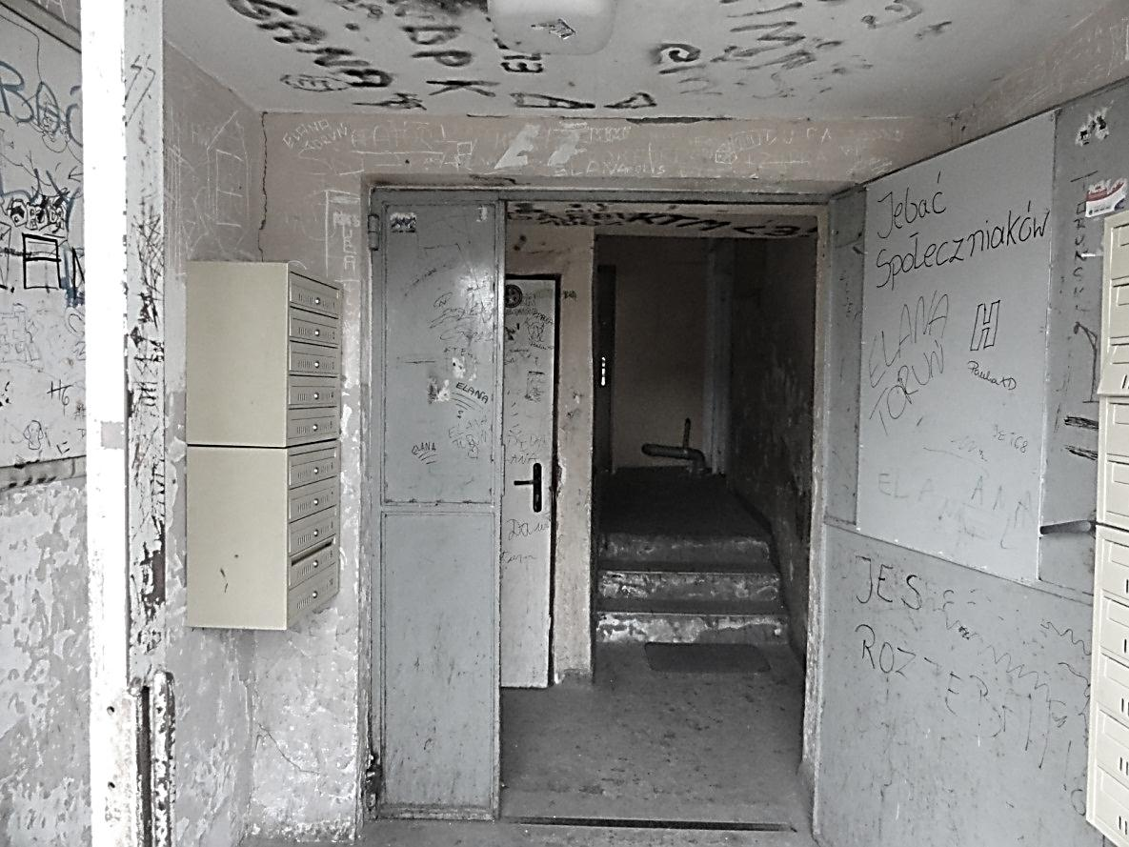
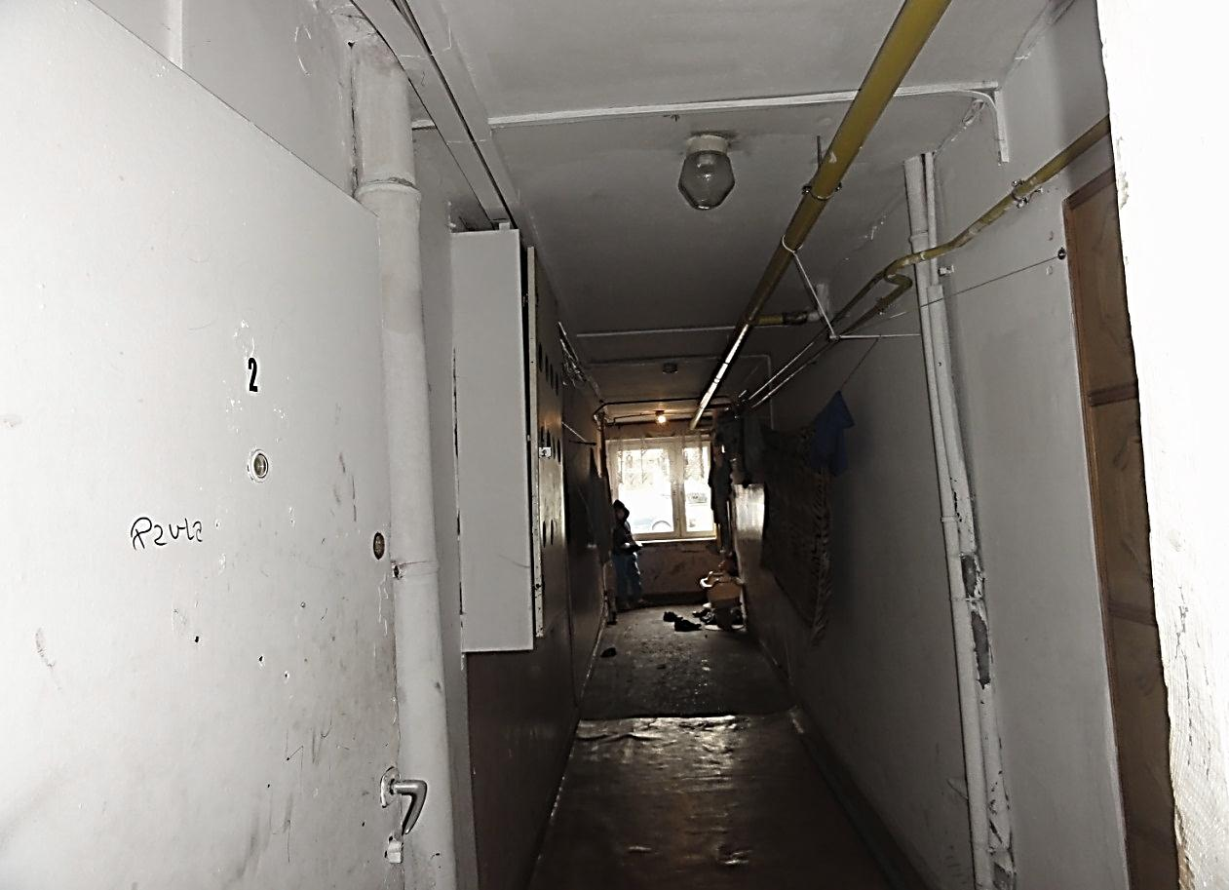
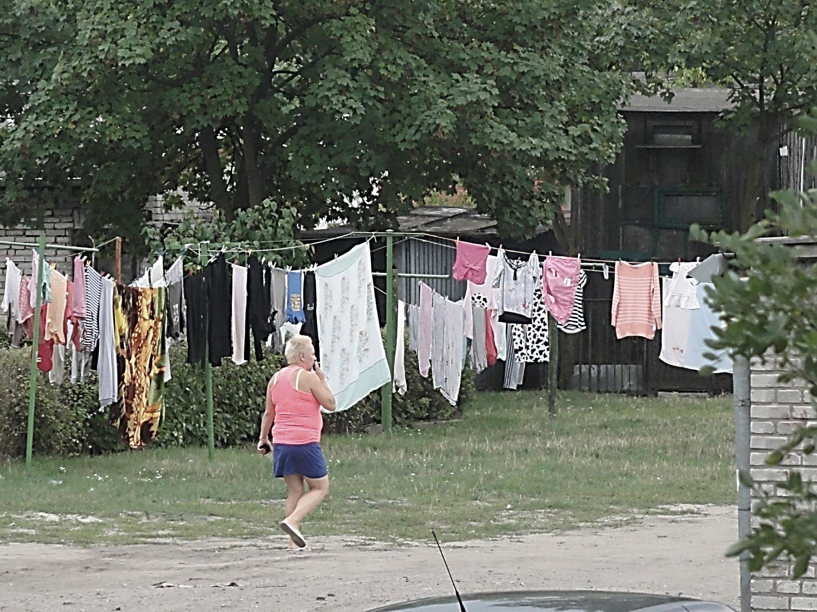
Dysfunctionality vs. urban-rural solutions: Can it work?
Mistra Urban Futures , Urban Research Seminar, “Wicked problems or wicked solutions? Sustainability–differently”

Slide 20
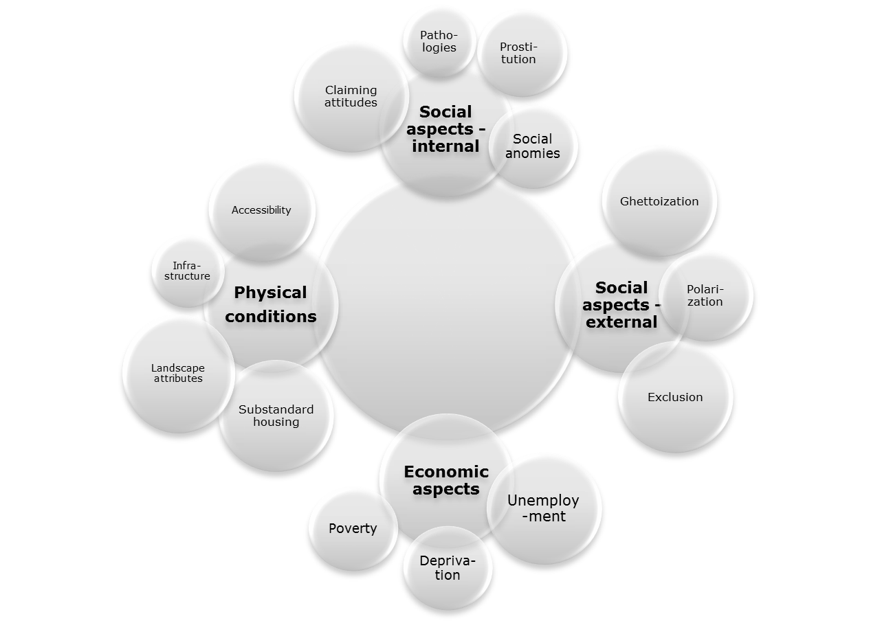
Dysfunctionality vs. urban-rural solutions: Can it work?
Mistra Urban Futures , Urban Research Seminar, “Wicked problems or wicked solutions? Sustainability–differently”
Because of their chaotic and incoherent nature, deprived „rural” and „urban” estates exude dysfunctionality.
Their dysfunctional character is noticeable in a wide array of dimensions:
Dysfunctionality

Slide 21
Dysfunctionality vs. urban-rural solutions: Can it work?
Mistra Urban Futures , Urban Research Seminar, “Wicked problems or wicked solutions? Sustainability–differently”
2. How do inhabitants perceive
rurality and urbanity?

Slide 22
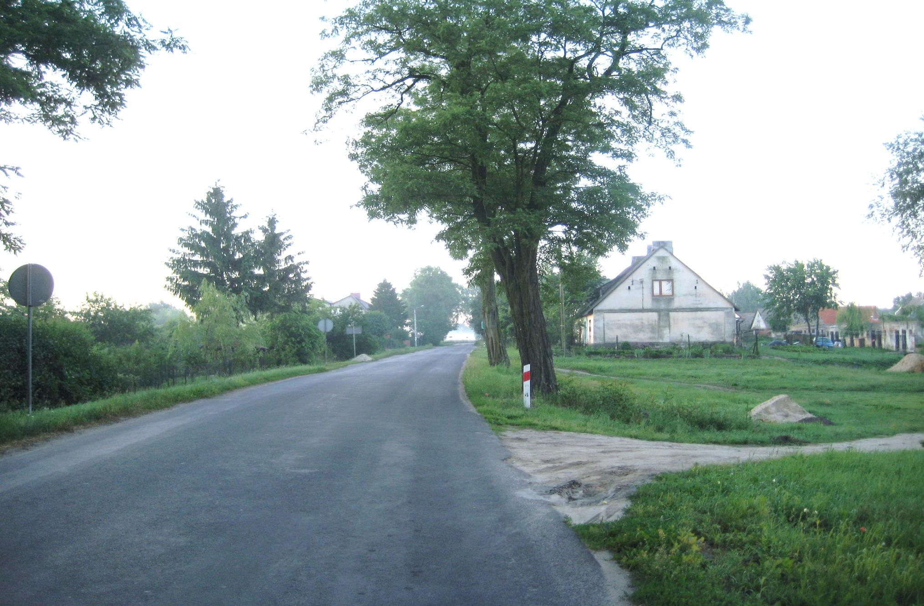
Dysfunctionality vs. urban-rural solutions: Can it work?
Mistra Urban Futures , Urban Research Seminar, “Wicked problems or wicked solutions? Sustainability–differently”
What word describes Chotel/Rolnicza in the best way?
Rolnicza is only becoming a city.
(Female, Rolnicza 'urban', 40–49)
Rural-urban difference is diminishing. Just look around.
(Male, Chotel 'rural', 50–59)
Perception: rurality/urbanity (1/3)

Slide 23
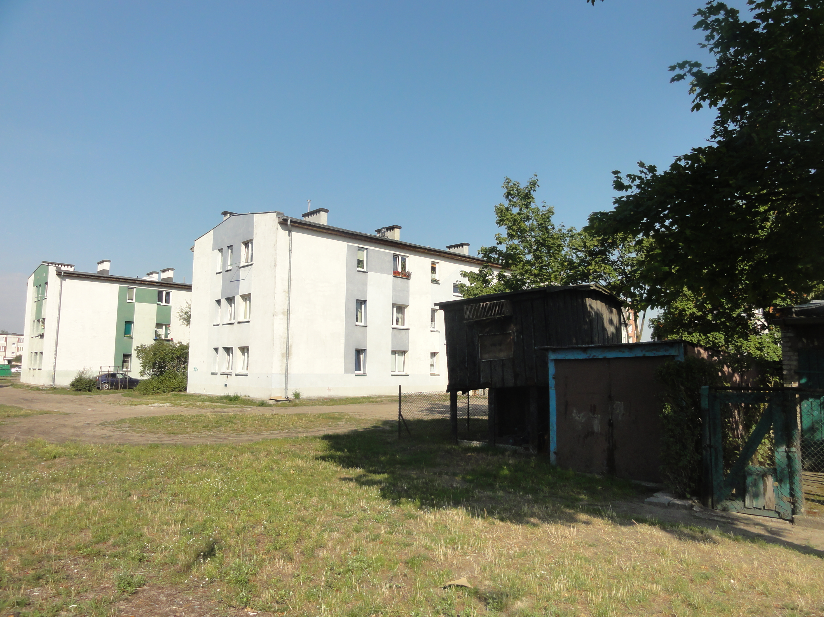
Dysfunctionality vs. urban-rural solutions: Can it work?
Mistra Urban Futures , Urban Research Seminar, “Wicked problems or wicked solutions? Sustainability–differently”
How would you describe the character of your place of residence?
It’s always been like this: the city and the countryside. But in fact this division is of little use. Isn’t the name of the settlement enough? (Male/Chotel/30-39)
The city and the countryside… what’s the point? It’s pure confusion. (Male/Rolnicza/40-49)
Perception: rurality/urbanity (2/3)

Slide 24
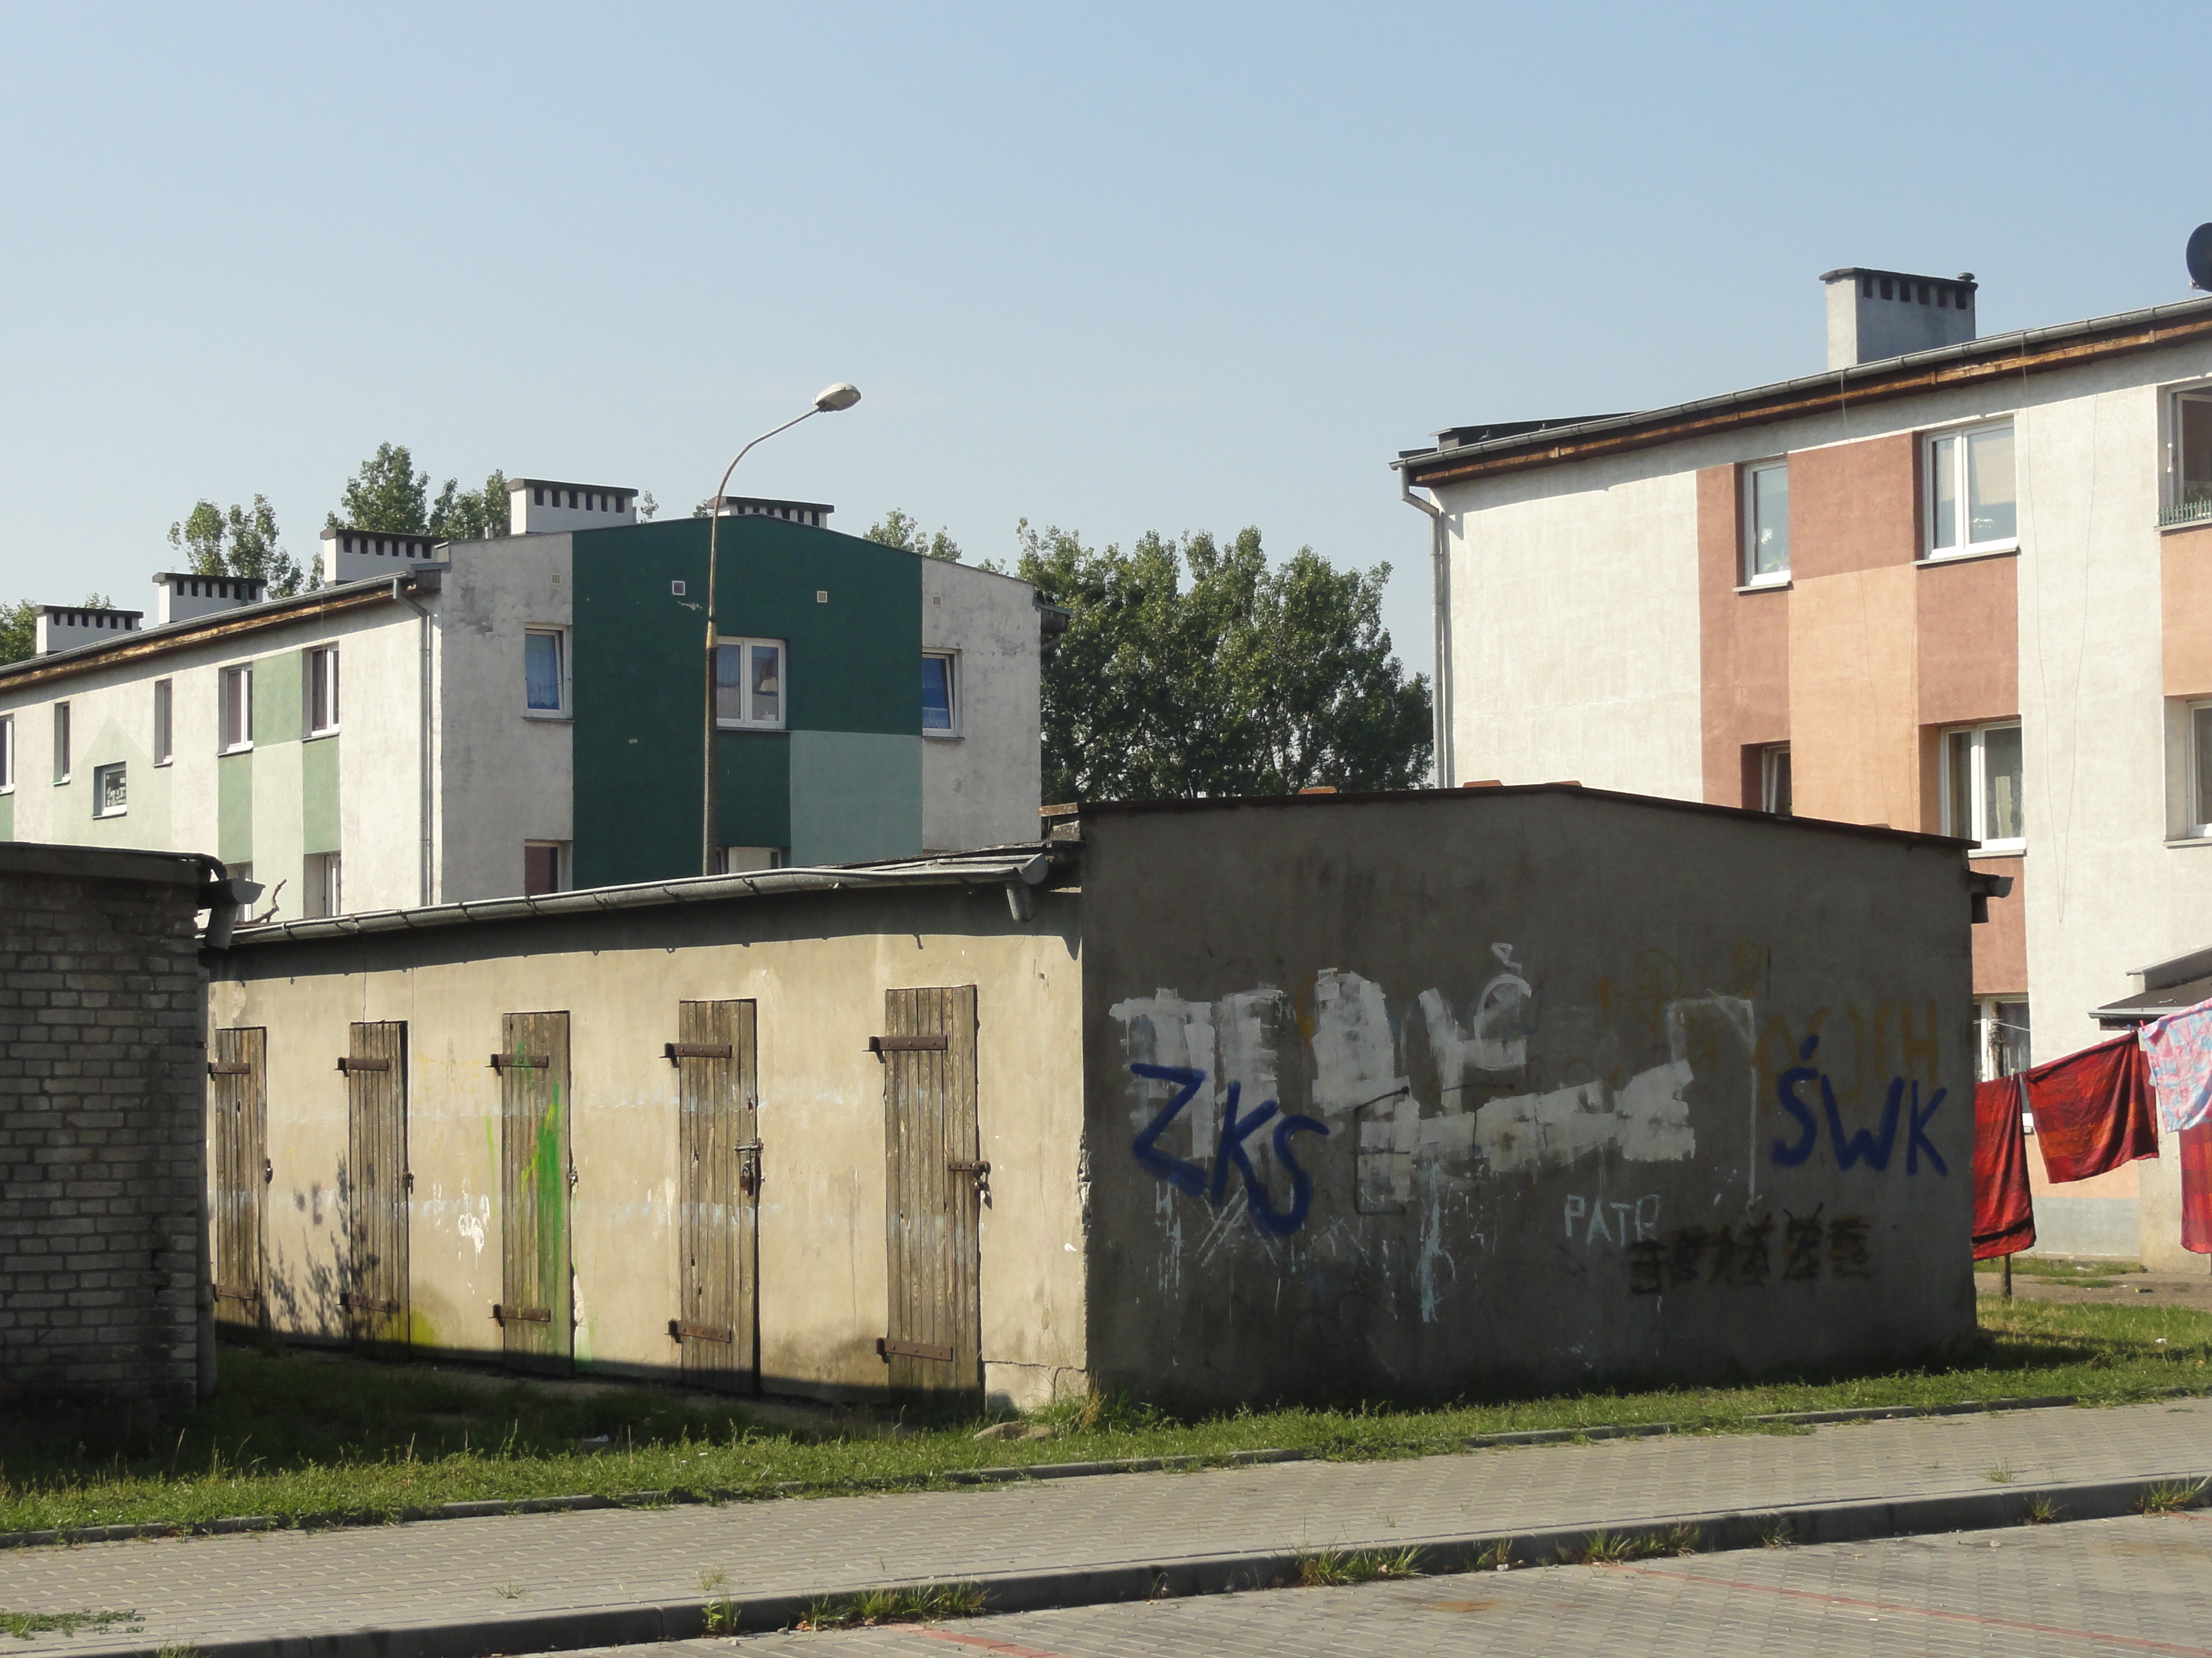
Dysfunctionality vs. urban-rural solutions: Can it work?
Mistra Urban Futures , Urban Research Seminar, “Wicked problems or wicked solutions? Sustainability–differently”
Where do you think people have more problems?
City? What city? Even from above it looks like some SAF.
(Male/Rolnicza/50-59)
The rural-urban divide discriminates people. (…) It’s not good. It shouldn’t be like that. It’s like dividing people into groups A and B, completely at random. (Female/Chotel/20-29)
Perception: rurality/urbanity (3/3)

Slide 25
Dysfunctionality vs. urban-rural solutions: Can it work?
Mistra Urban Futures , Urban Research Seminar, “Wicked problems or wicked solutions? Sustainability–differently”
Dysfunctionality
vs.
solutions

Slide 26
Dysfunctionality vs. urban-rural solutions: Can it work?
Mistra Urban Futures , Urban Research Seminar, “Wicked problems or wicked solutions? Sustainability–differently”
Urban-rural implications for the local policy
1. Different creation of large cities and rural areas
Toruń – one of the largest cities in Poland, UNESCO Heritage site
Toruń is "a modern city within European development space” [A, p. 8] assuming the perspective of a wealthy metropolitan unit with great potential. Being a major tourist attraction (it is a UNESCO World Heritage site), its center sees many investments to the detriment of outer areas [B, pp. 43-44].
A - Toruń City Development Strategy 2020 (2010),
B - Local Revitalization Program 2007-2015. Resolution No. 903/14 of the Toruń City Council from2014-11-13, update.
Izbica Kujawska: agriculture as a basis for development and remedium for rural problems
The development of agriculture constitutes the basic condition for the improvement of quality of life for the rural population (…). Increasing the living standard of the rural residents will be provided through: improving the profitability of agricultural production; organization of the rural community into producer groups or agricultural circles; [and] creating conditions for the wholesale of agricultural produce. [C, p. 28]
C - Development Strategy of Izbica Kujawska 2000-2015 (2000).

Slide 27
Dysfunctionality vs. urban-rural solutions: Can it work?
Mistra Urban Futures , Urban Research Seminar, “Wicked problems or wicked solutions? Sustainability–differently”
Urban-rural implications for the local policy
2. Urban-rural rhetoric in strategic documents
Toruń: Urban characterizations
“the support of urban institutions” (p. 42),
“the equipment of urban healthcare facilities” (p. 44),
“urban recreation” (p. 44),
“evolving a comprehensive urban system of investment information” (p. 54).
Toruń City Development Strategy 2020 (2010), but also The Investing Toruń 2013-2022, Planning principles and finances. (2013)., Resolution No. 26/2015 of the Toruń City Council from 2015-01-22 on the Budget of the City of Toruń for 2015
Izbica Kujawska: Rural characterizations
“the improvement of quality of life for the rural population” (p. 28),
“organization of rural community” (p. 28).
Development Strategy of Izbica Kujawska 2000-2015 (2000).

Slide 28
Dysfunctionality vs. urban-rural solutions: Can it work?
Mistra Urban Futures , Urban Research Seminar, “Wicked problems or wicked solutions? Sustainability–differently”
Urban-rural implications for the local policy
3. Practical actions of „urban” and „rural” assistance institutions
Research Report – Assistance and social integration of selected groups – a diagnosis of standardization of services and institution models (2011), p. 49:
The opportunities to obtain assistance for people in difficult life situations are mainly determined by the formal status of the estate or settlement. While cities report a high standard of social assistance services, the standard of such services in the countryside is described as low.
Here in the city we have a larger institutional base, NGOs, different foundations; in the countryside they don’t have that.
(Officer from Toruń)
a. different philosophy of activities;
b. cooperation with specialists and institutions
c. conduction or commission of research and expert reports
[Their] difficult life situation is due to their laziness and negligence, and therefore we should support other priority goals. (Officer from Izbica Kujawska)

Slide 29
Dysfunctionality vs. urban-rural solutions: Can it work?
Mistra Urban Futures , Urban Research Seminar, “Wicked problems or wicked solutions? Sustainability–differently”
Summary of research results
The results of different studies show that the real problems of people inhabiting de iure “rural” and “urban” areas are the same: in economic, social and material dimensions.
Moreover, formal classification of deprived estates does not correspond to the features commonly associated with “rural” and “urban”. Hence, their character is mainly described as “rural-urban” and diagnozed residents’ problems are the same.
Regardless of the real nature of deprived areas, the formal classification is the basis to obtain assistance. It means that the aid programs do not target the right needs.

Slide 30
Dysfunctionality vs. urban-rural solutions: Can it work?
Mistra Urban Futures , Urban Research Seminar, “Wicked problems or wicked solutions? Sustainability–differently”
Conclusion
Wicked problems…
Deprived estates experience wicked problems but their appropriate diagnosis could be the starting point for finding solutions.
Wicked solutions…
The urban-rural “artificial filter” employed for solving problems in deprived estates is not useful. Moreover, it makes the residents' situation increasingly complicated.

Slide 31
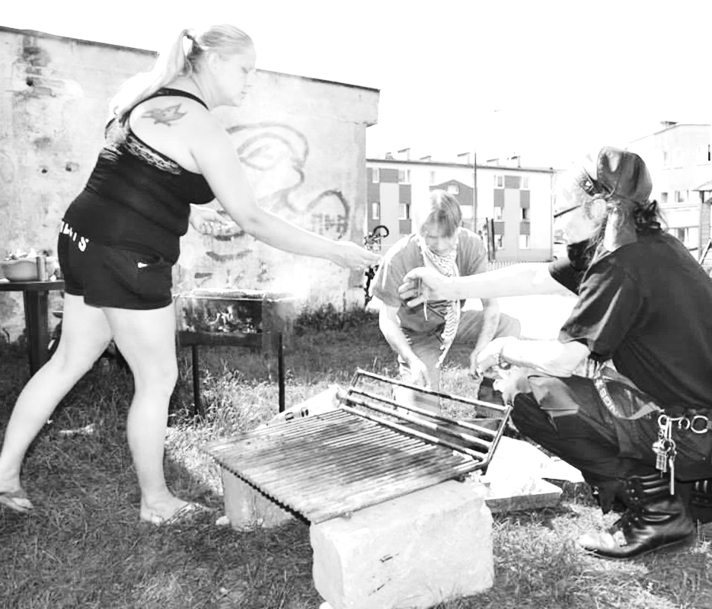
Dysfunctionality vs. urban-rural solutions: Can it work?
Mistra Urban Futures , Urban Research Seminar, “Wicked problems or wicked solutions? Sustainability–differently”
A final reflection
Broadly perceived equal rights policy entrenched in the globally understood sustainability may be differently construed at the local level.
But is it still sustainability?

Slide 32
Dysfunctionality vs. urban-rural solutions: Can it work?
Mistra Urban Futures , Urban Research Seminar, “Wicked problems or wicked solutions? Sustainability–differently”
Thank you for your listening!

